Slide 1


24HPC Award CEREMONY of NOT-QUITE hidden categories

Slide 2
THE ARCHITECT
Award for earning the highest ratio of their total points from SKYSCRAPERS puzzles
Ana Karmelić 25,5%

Slide 3
HIGH FIVE
Award for earning the highest ratio of their total points from PENTOMINO related puzzles
Renier Schmiermann 13,9%

Slide 4
I’ve GOT TAPAWER
Award for earning the highest ratio of their total points from TAPA puzzles
Kersti Kivisoo 10,8%
Richard Luhtaru 10,8%

Slide 5
I CAME TO THE 24HSC
Award for earning the highest ratio of their total points from SUDOKU puzzles
Tomáš Krejčí 38,6%

Slide 6
KING OF THE MOUNTAINS
Award for earning the highest ratio of their total points from HIGH VALUE puzzles
Lichý Petr 36,0%

Slide 7
THE COUNT OF THE SHAPES
Award for the most detailed solution path

Slide 8
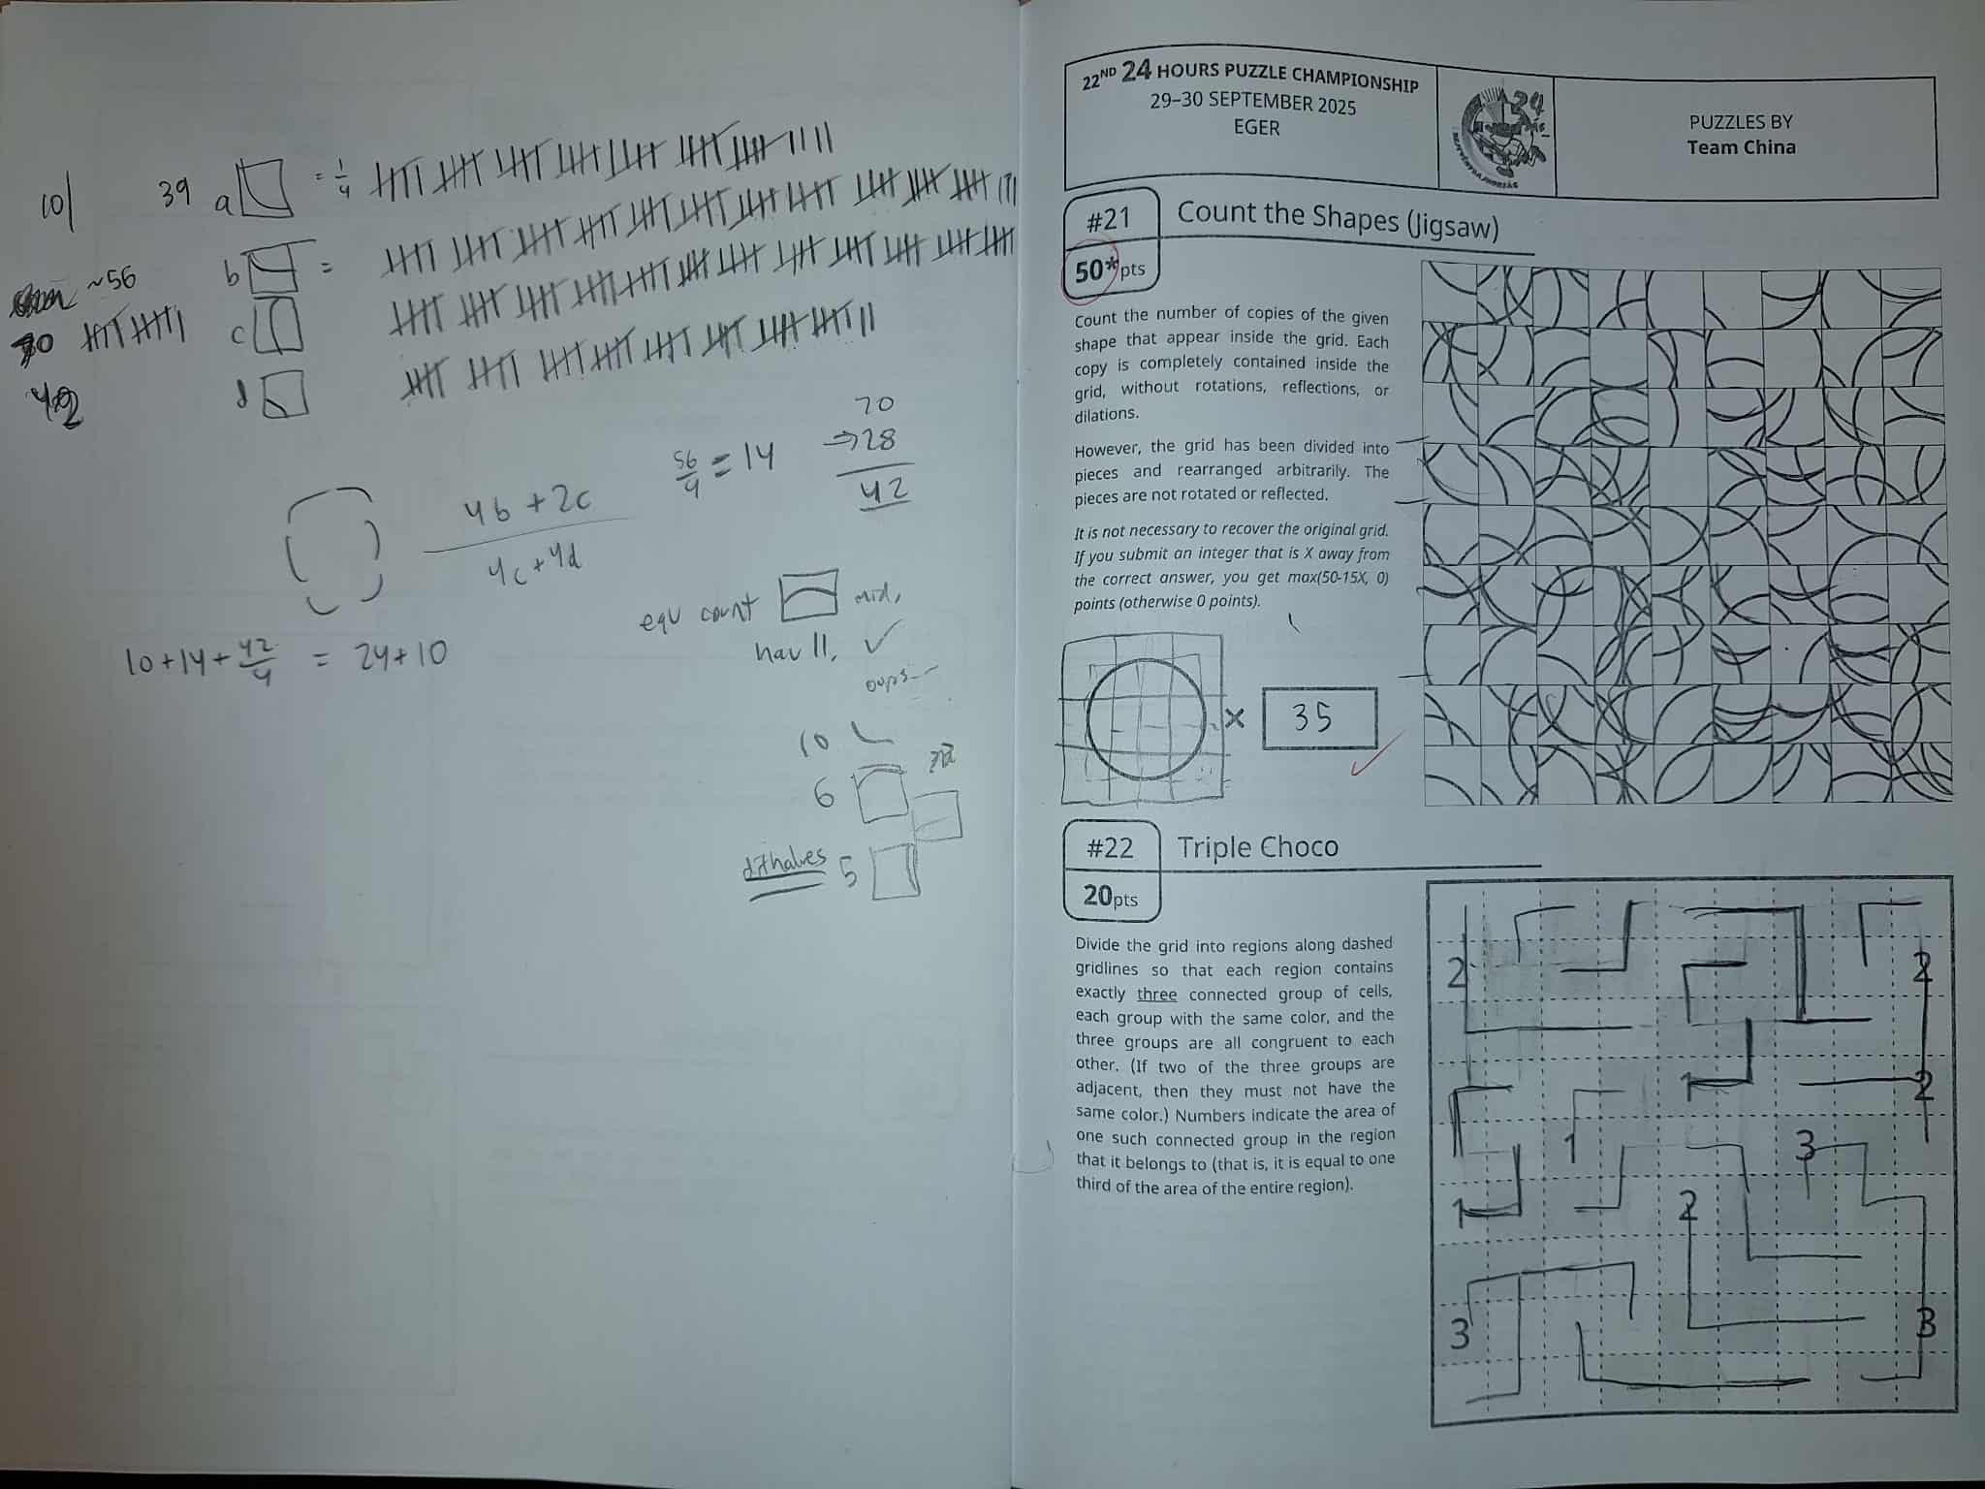
Nicholai Dimov

Slide 9
LITERALLY TAKEN
Award for finding a broken puzzle in R10

Slide 10
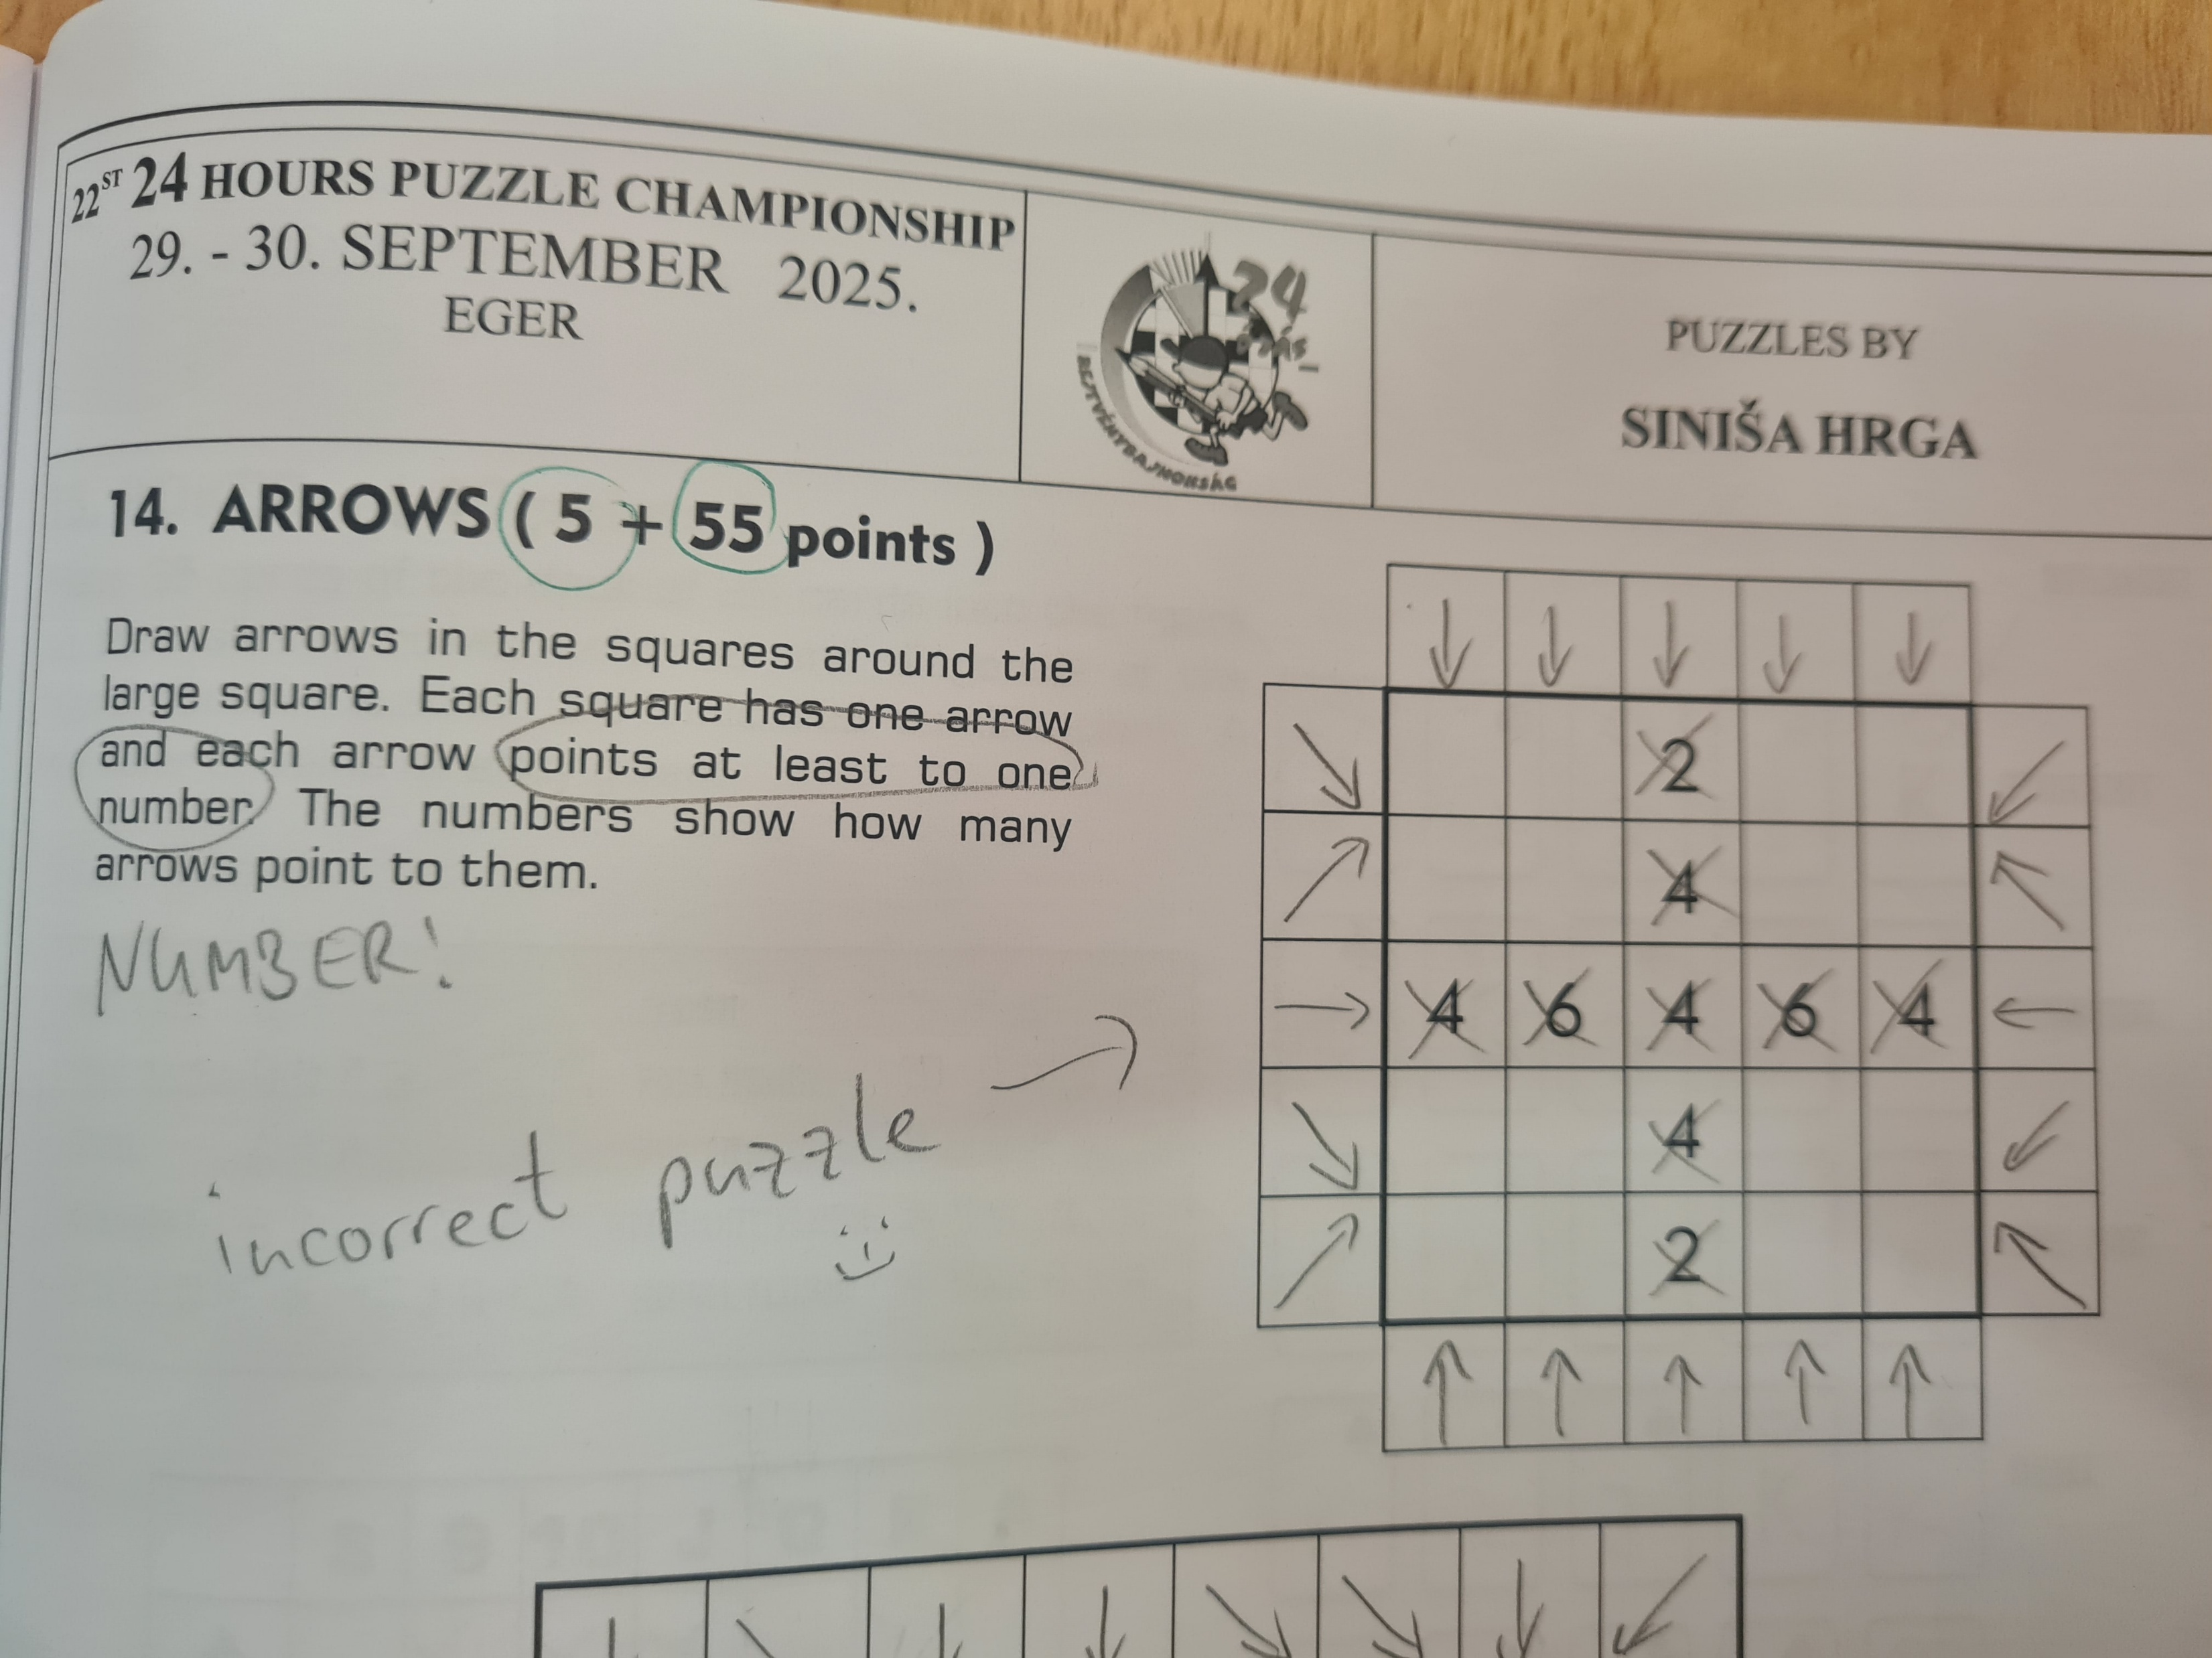
Ulrich Voigt

Slide 11
HARVEST
Award for the best alternative solution

Slide 12
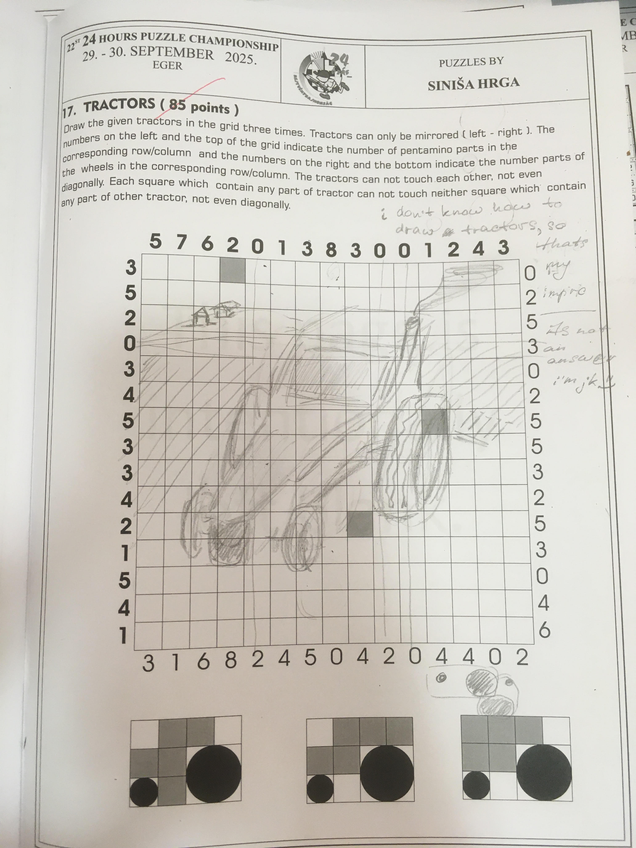
Alena
Klyachina

Slide 13
MIRACLE IN EGER
Award for earning more points than Ken Endo in any round

Slide 14
Qiu Suzhe: Round 5 and 8
Thomas Luo: Round 11
Kota Morinishi: Round 11

Slide 15
SUPERB OWL
Award for earning the highest ratio of their total points from the NIGHT ROUNDS

Slide 16
SUPERB OWL
1.Jan Onderek 1,72
2.Michaela Šaffová 1,53
3.Zdeněk Vodička 1,53

Slide 17
NEWCOMER
1. Suzhe Qiu 1084,46
2. Rintaro Matsumoto 860,59
3. Hu Yuxuan 855,64

Slide 18
OVER 50
1. Wei-Hwa Huang 602,52
2. Jana Vodičková 463,92
3. Veronika Lengauer 345,58

Slide 19
UNDER 18
1. Suzhe Qiu 1084,46
2. Ramazan Fıstıckı 505,08
3. Özgün Onur Özdemir 390,59

Slide 20
OVERALL
1.Ken Endo 1280,26
2. Thomas Luo 1139,36
3. Suzhe Qiu 1084,46

Slide 21
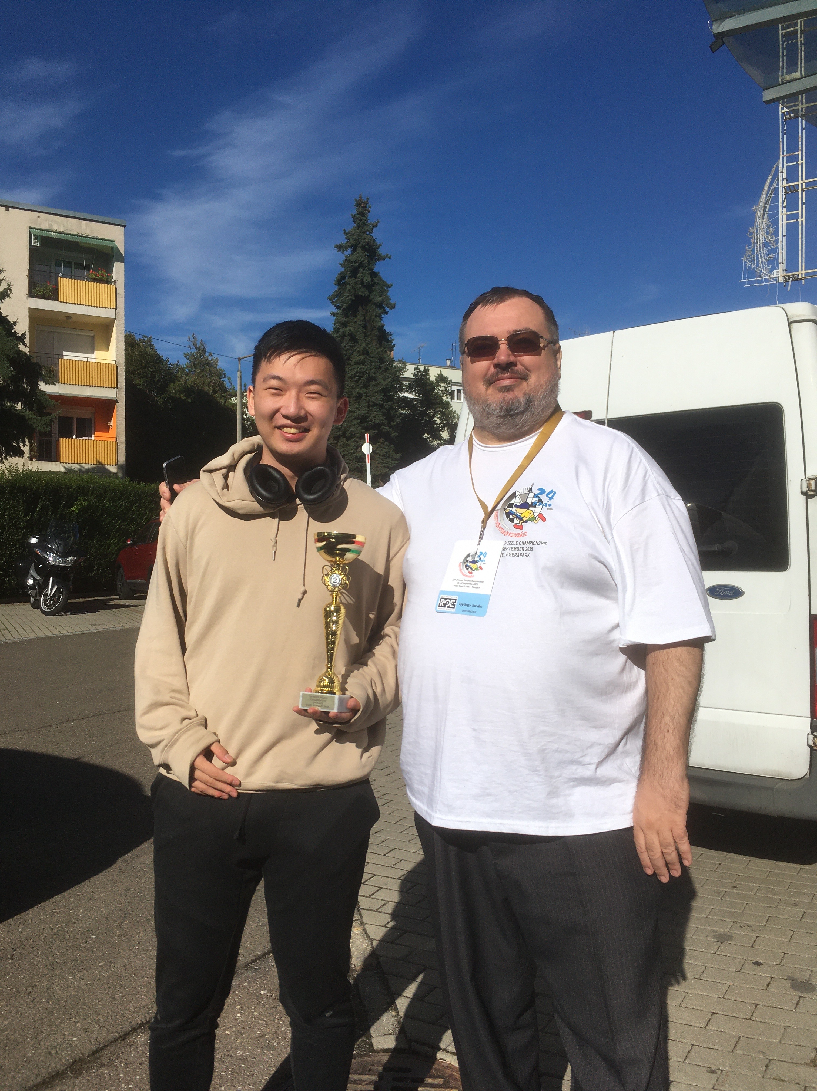

Slide 22
TRIATHLETE
Award for the best combined results at WSC+WPC+24HPC

Slide 23
TRIATHLETE
1. Ken Endo 6+2+1=9
1. Suzhe Qiu 2+4+3=9
3. Kota Morinishi 3+8+5=16

Slide 24
SCORING ROOM At
5:00AM

Slide 25


Slide 26
HOW TO IMPROVE?

Slide 27
