Slide 1
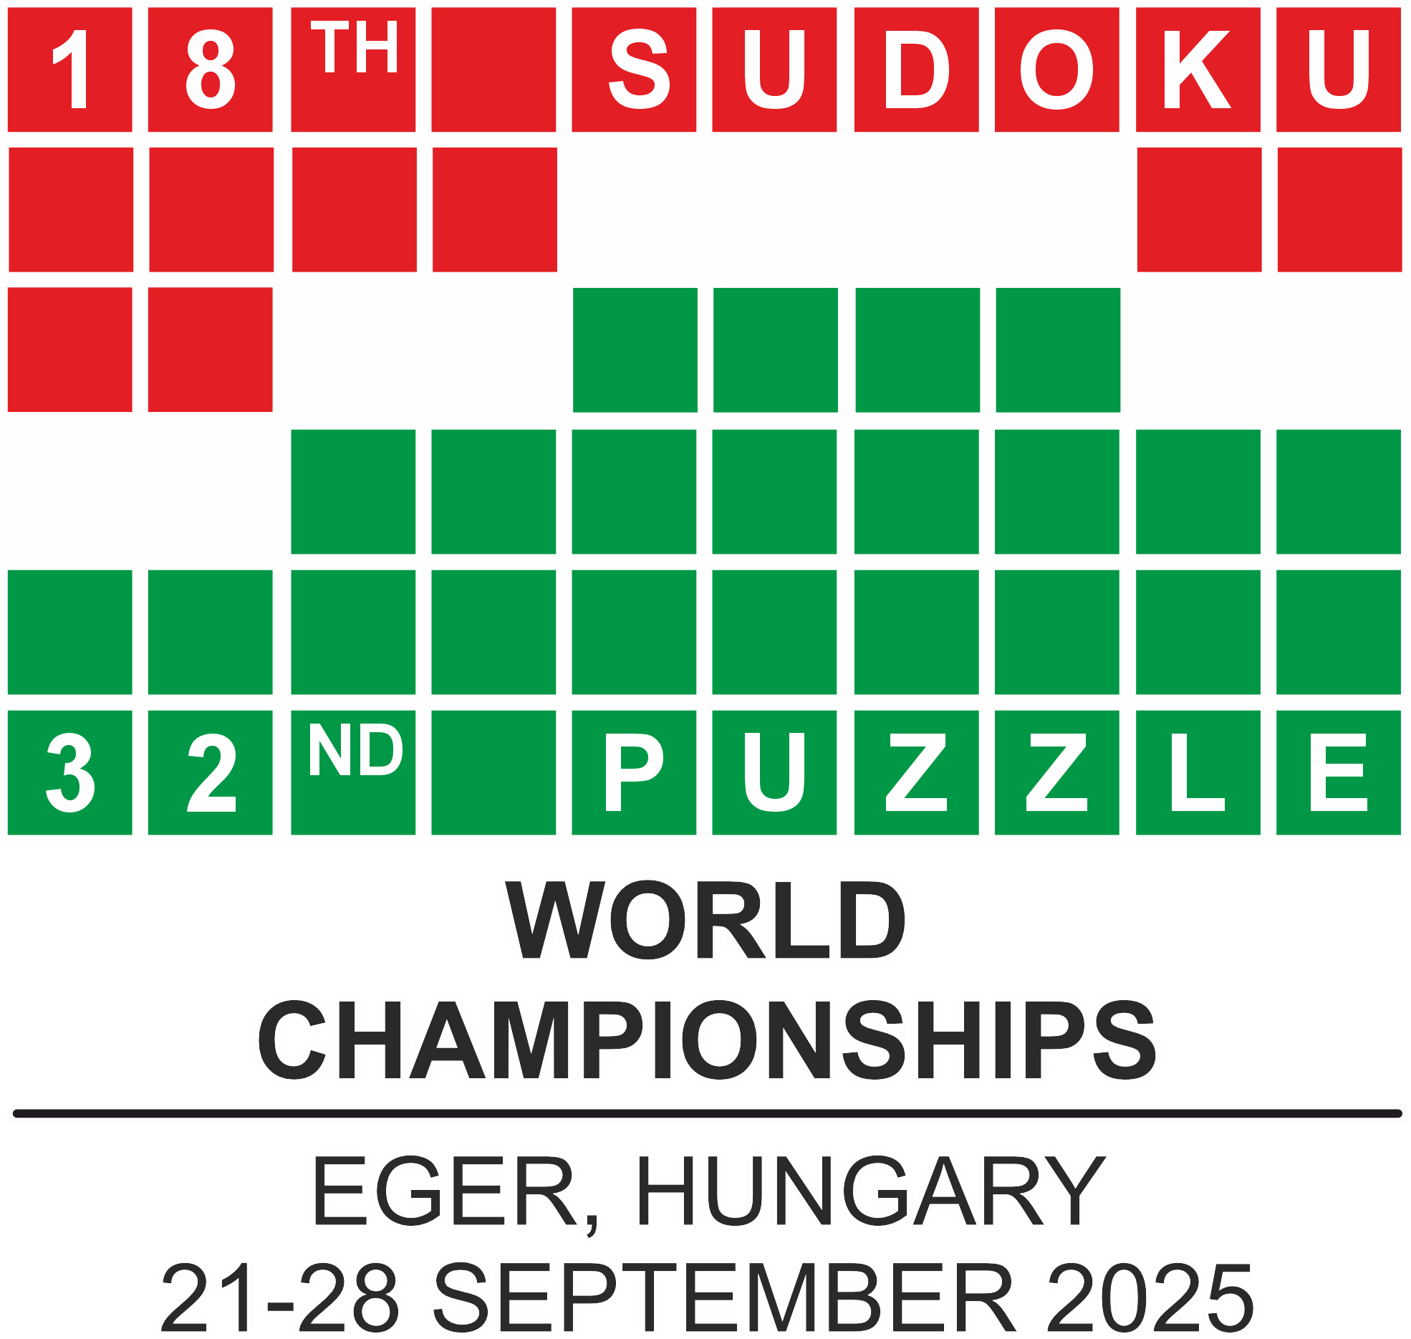
Crossword championship

Slide 2

1st Ulrich Voigt
2nd Édouard Lebeau
3rd Joonas Jürgen Kisel

Slide 3
CrYSTAL BALL

Slide 4
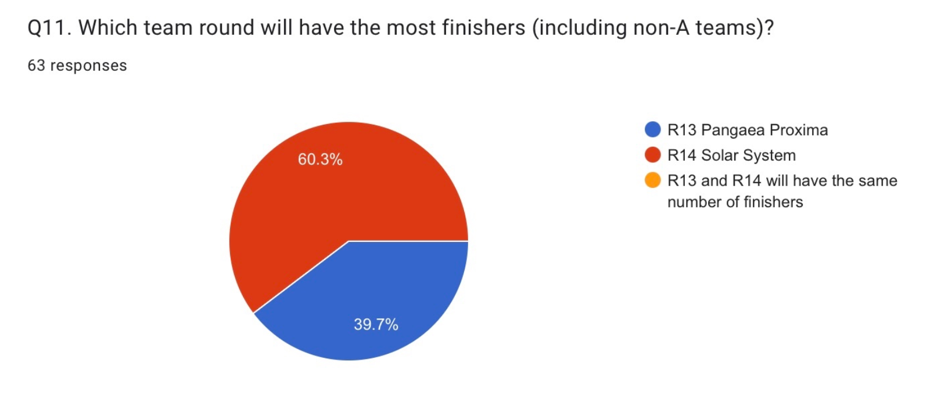
6-6 finishers

Slide 5
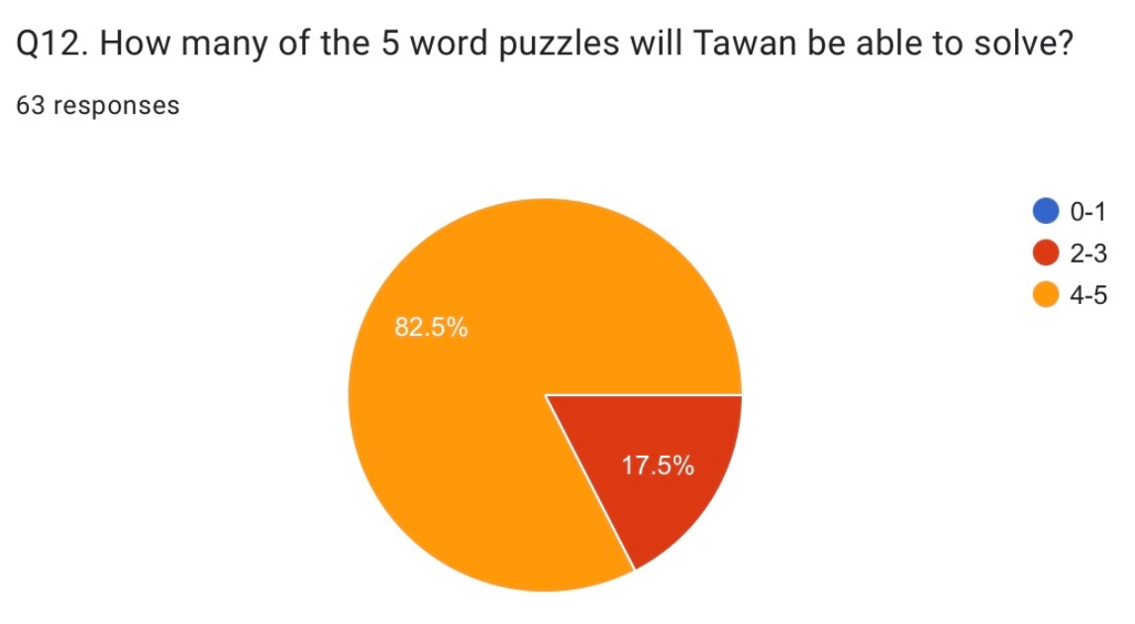
He solved 3

Slide 6
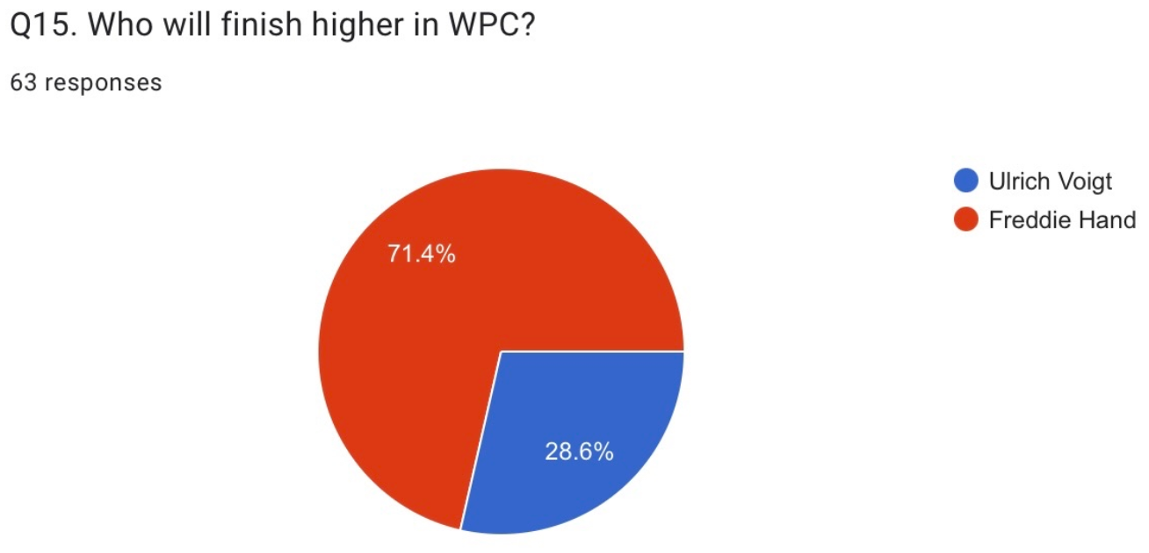
Freddie

Slide 7
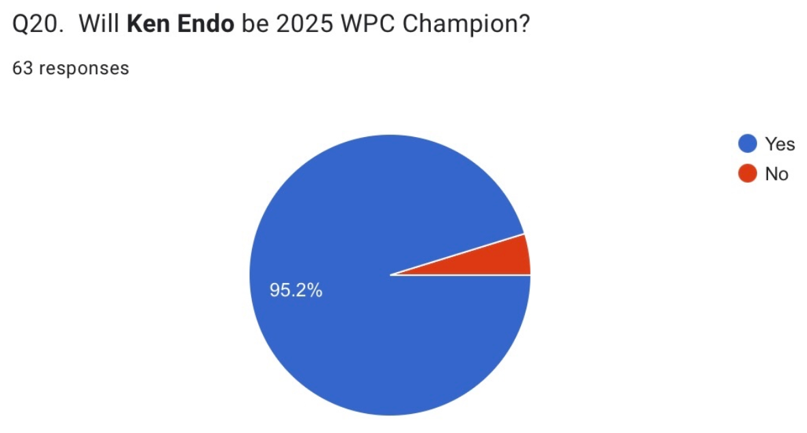
He finished 2nd

Slide 8
1st Sed Holaysan
2nd Veronika Kolvekova
3rd Maciej Ignaciuk

Slide 9
WPC Award CEREMONY of hidden categories

Slide 10
NOSTRADAMUS

Slide 11
Guess versus reality
5732 vs 5730

Slide 12
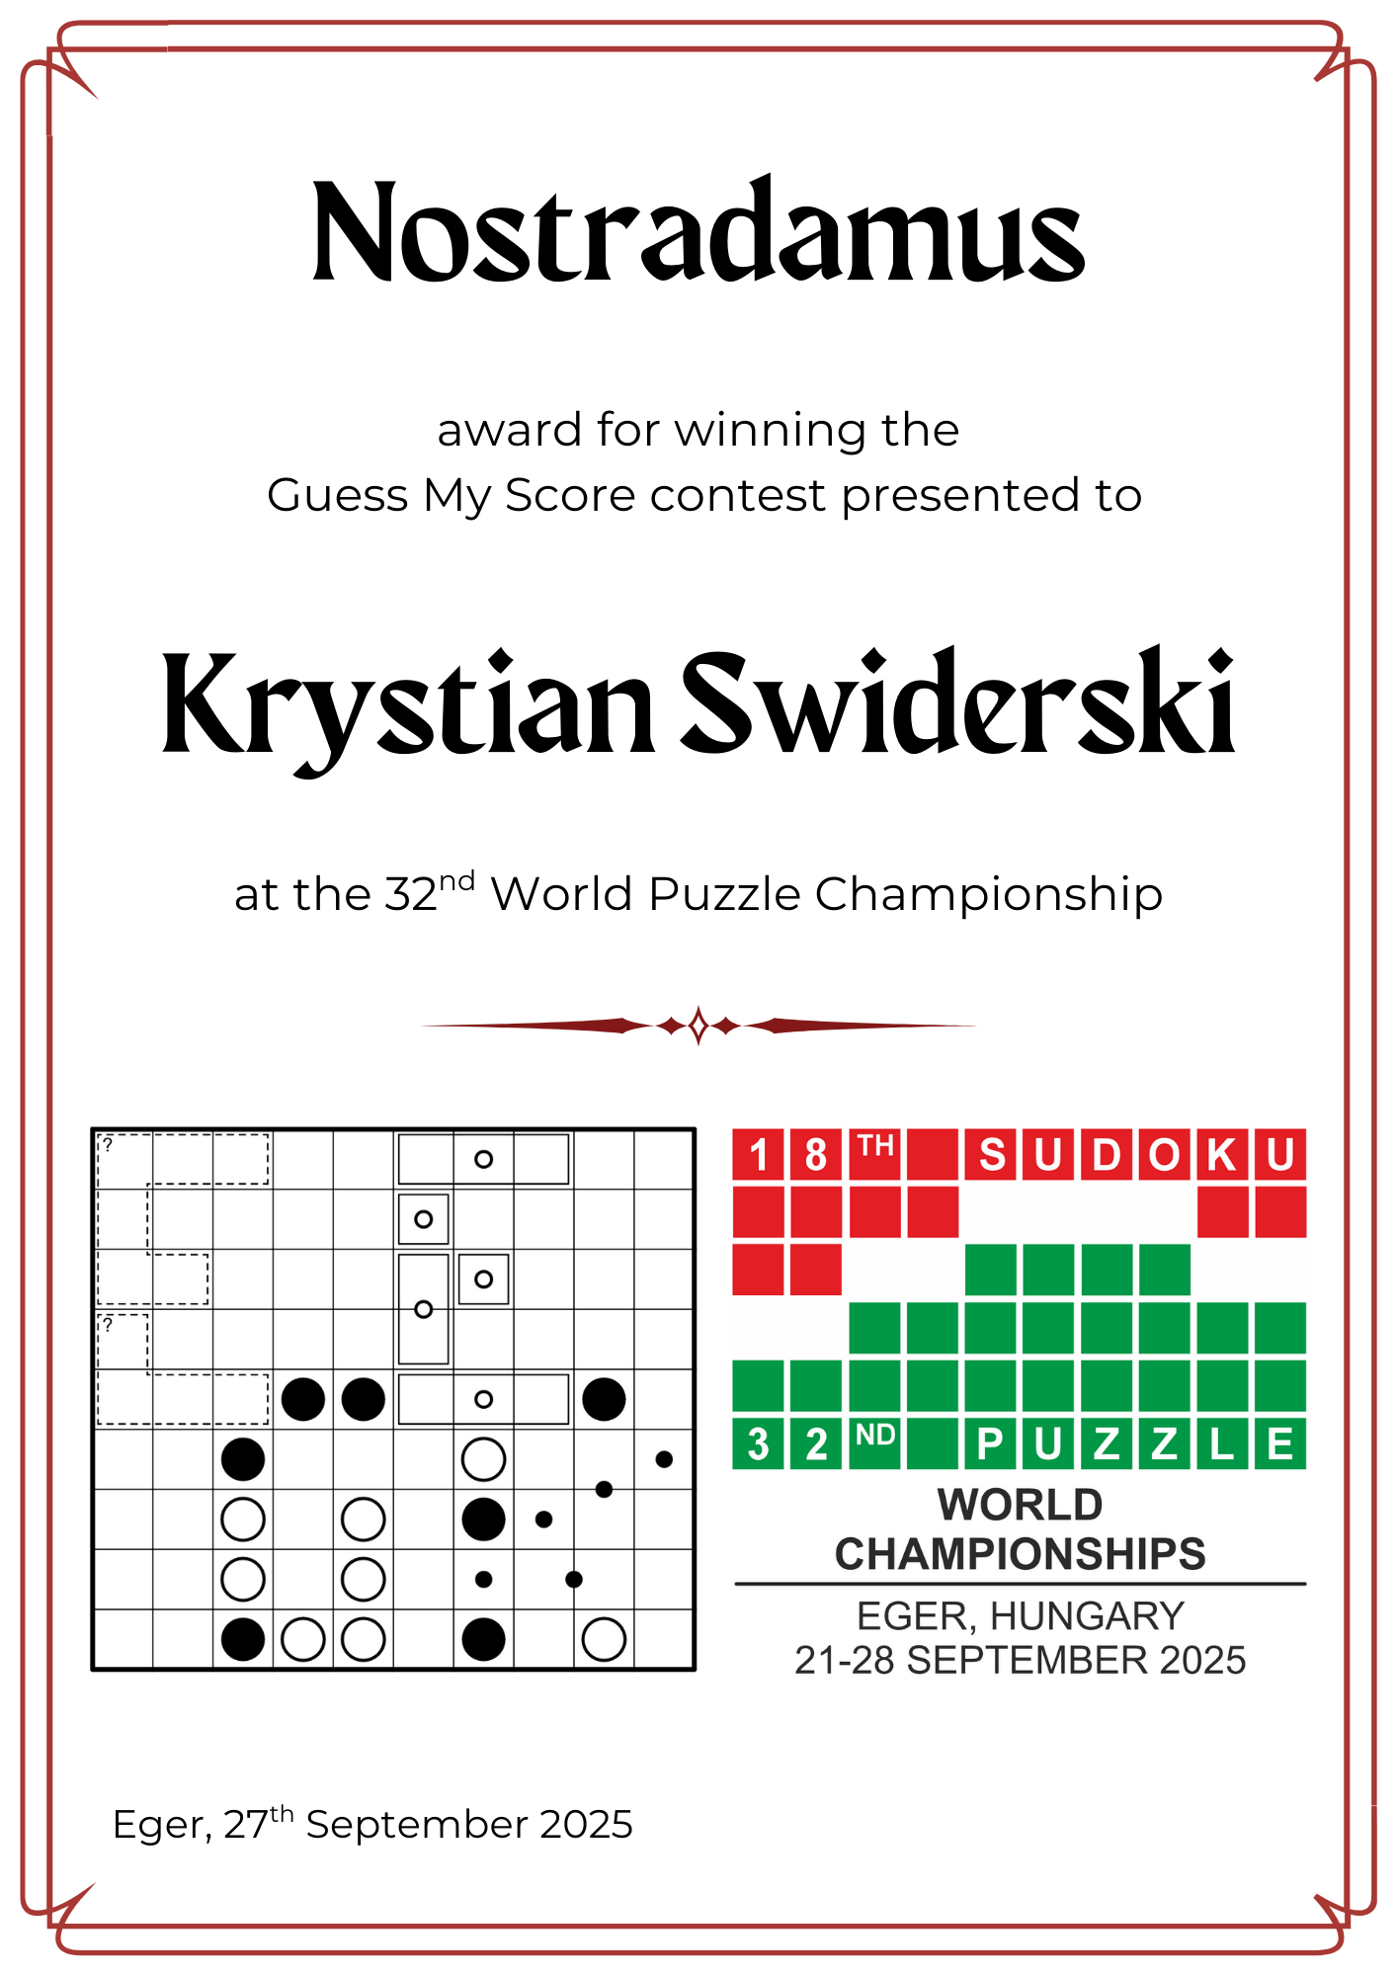

Slide 13
INCURABLE OPTIMIST

Slide 14
Guess versus reality
6666 vs 1740

Slide 15
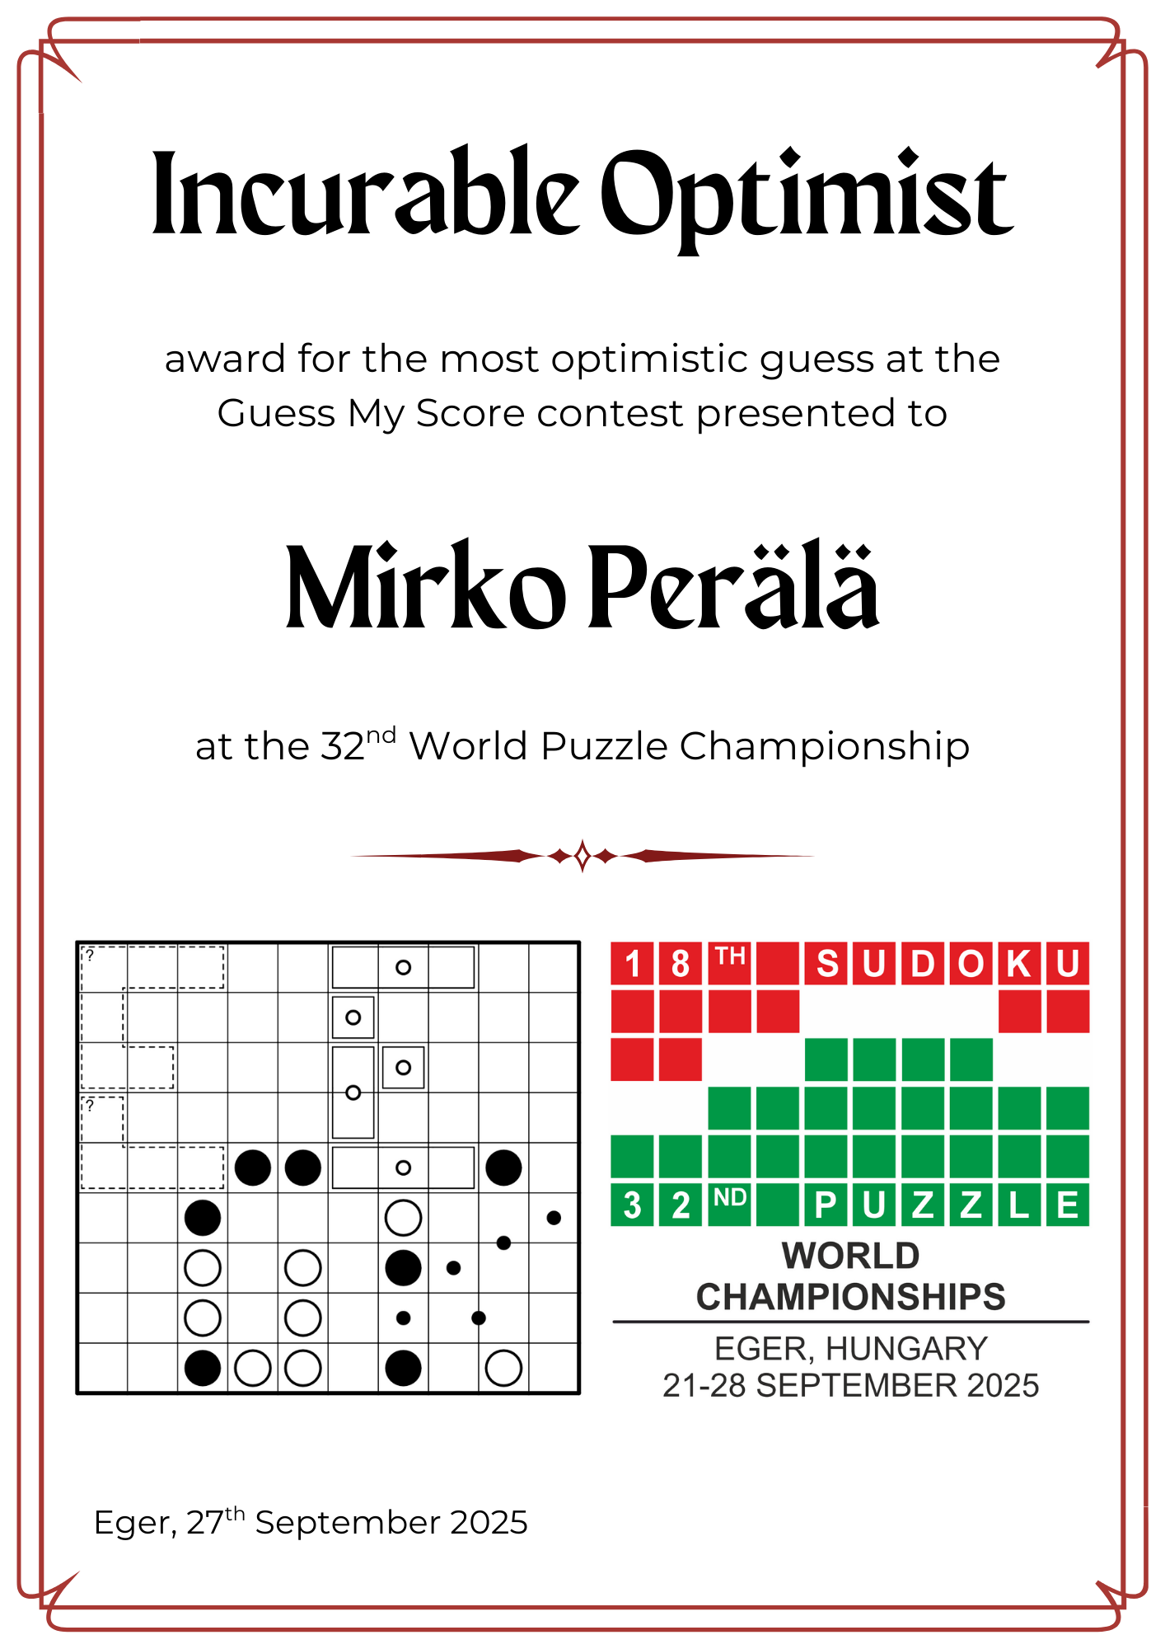

Slide 16
BELIEVE IN YOURSELF

Slide 17
Guess versus reality
3306 vs 8015

Slide 18
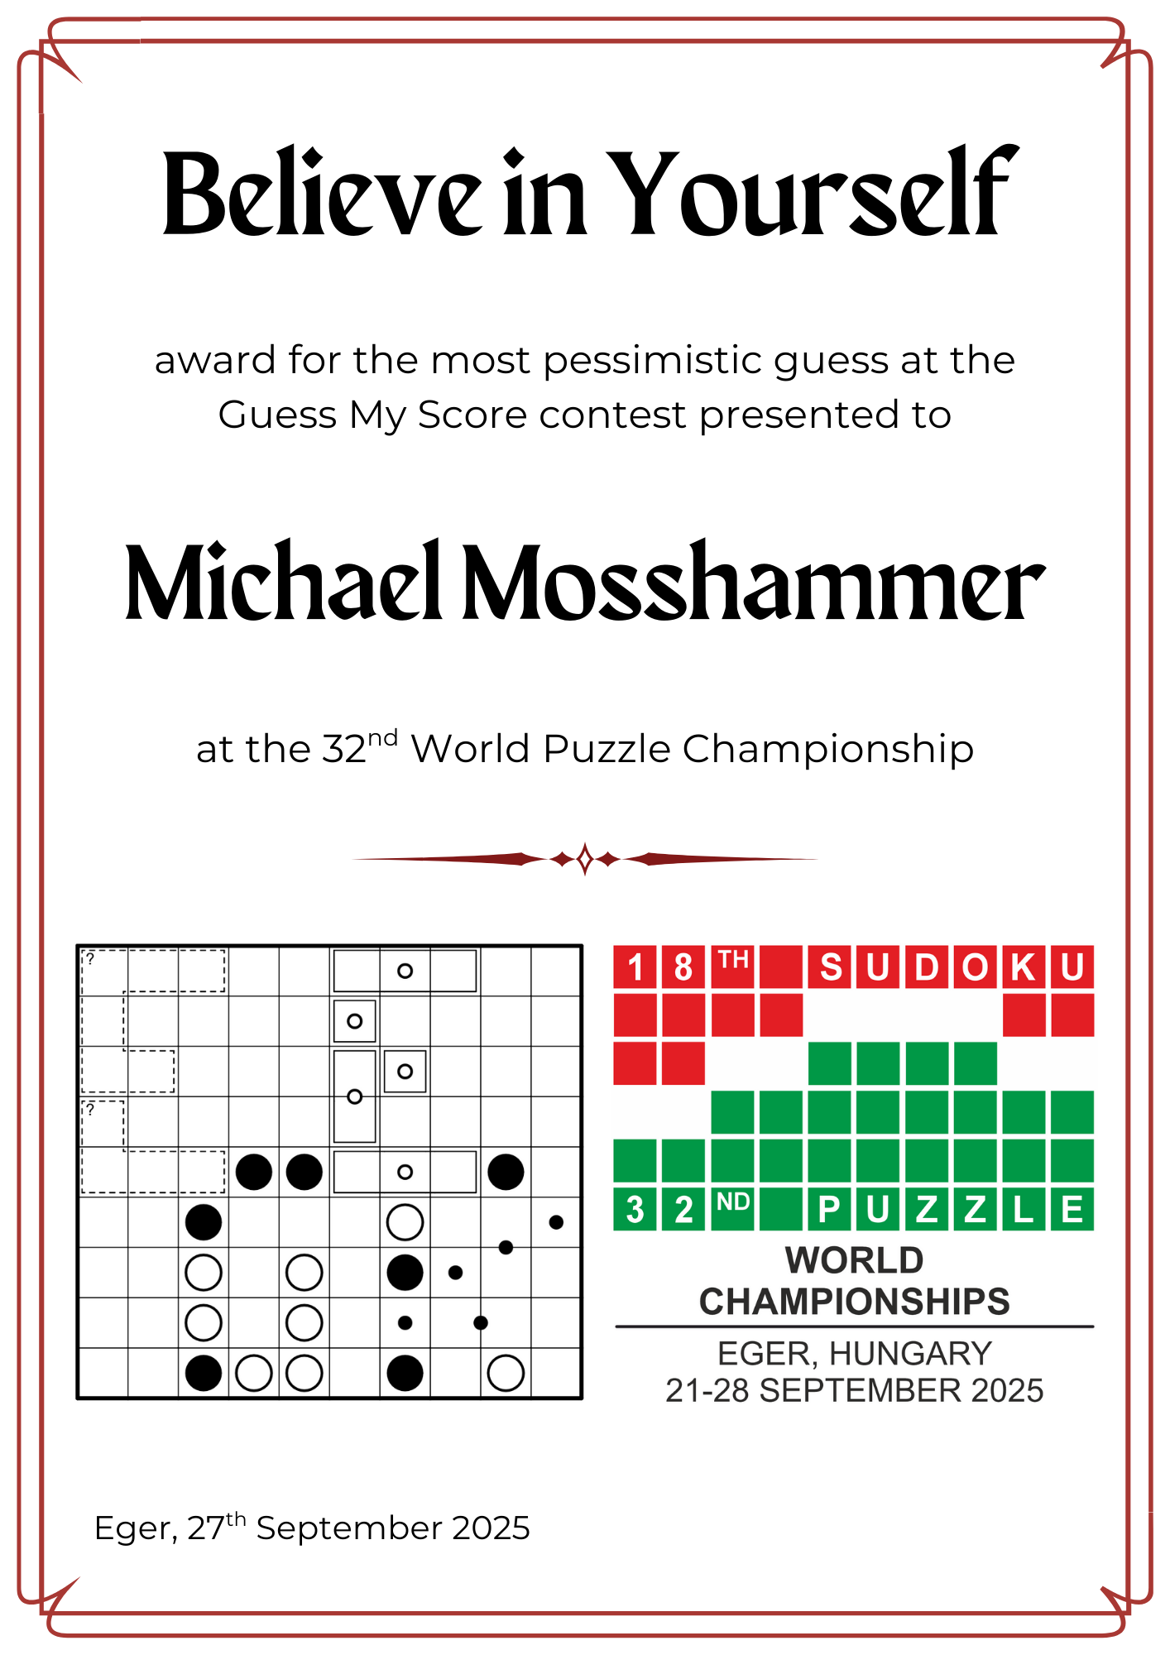

Slide 19
TWO PEAS IN A POD
THREE

Slide 20
FINAL SCORE = 3960
144.

Slide 21
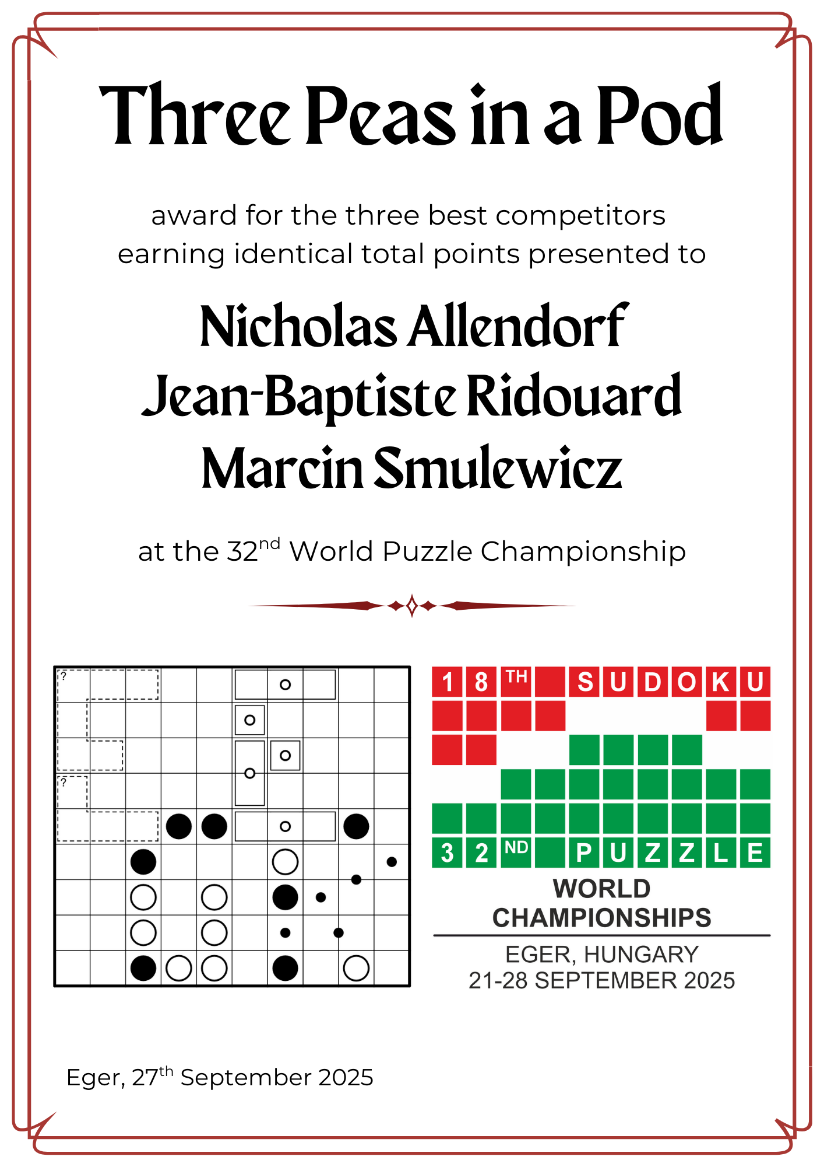

Slide 22
MY LUCKY NUMBER

Slide 23
Which one is the lucky number?
13
21
49
7
100

Slide 24
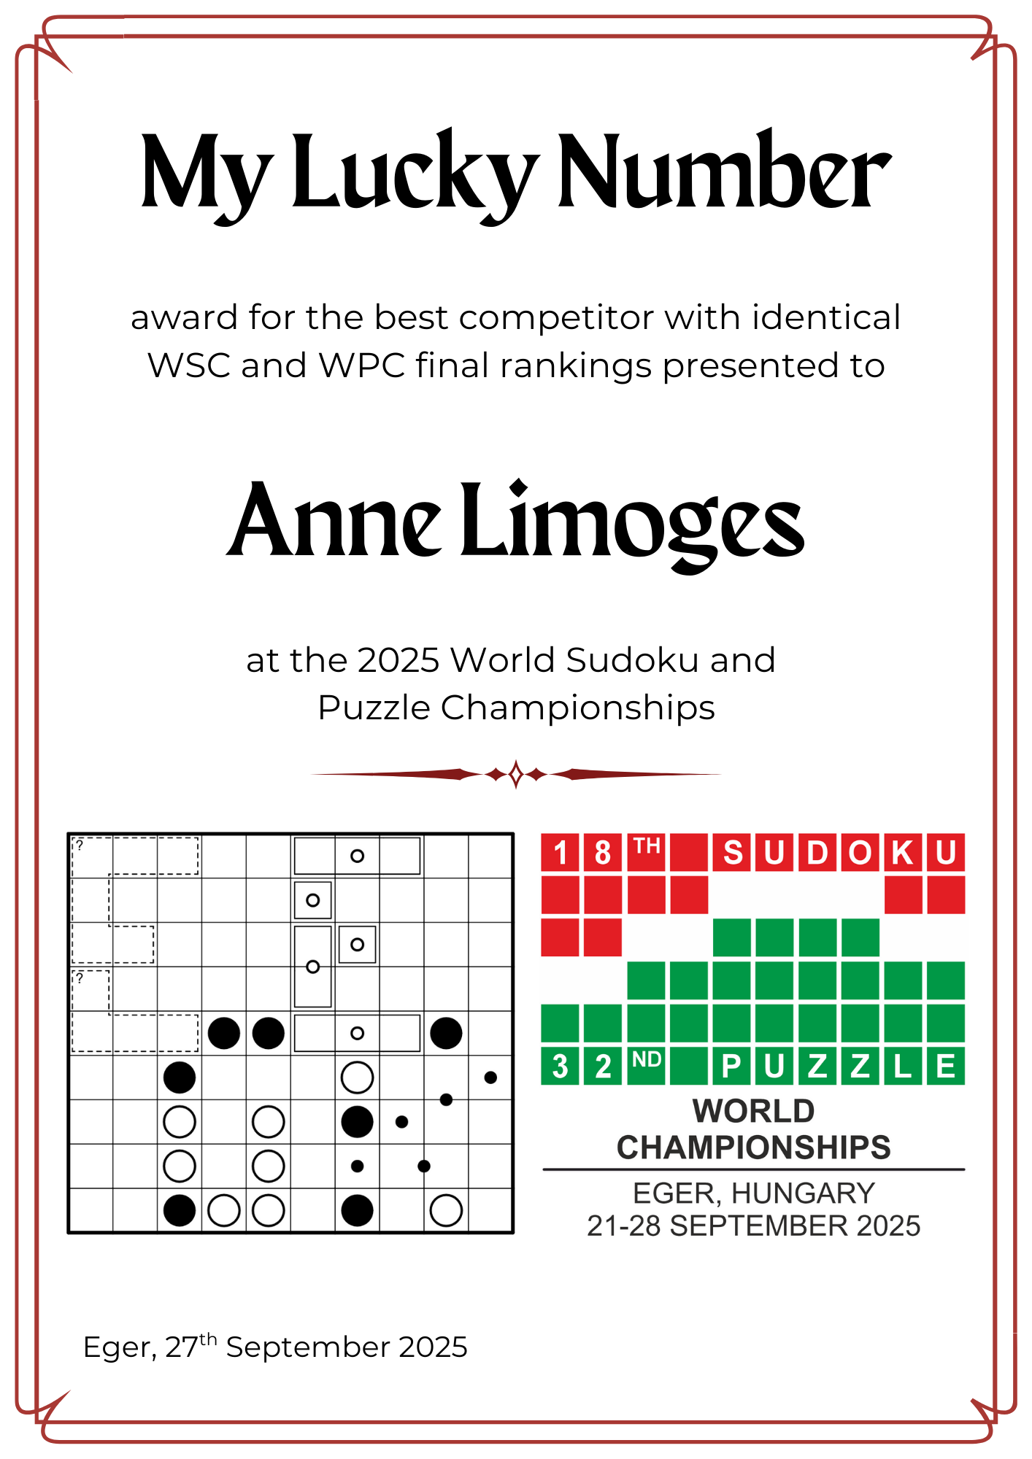

Slide 25
PLAN B

Slide 26
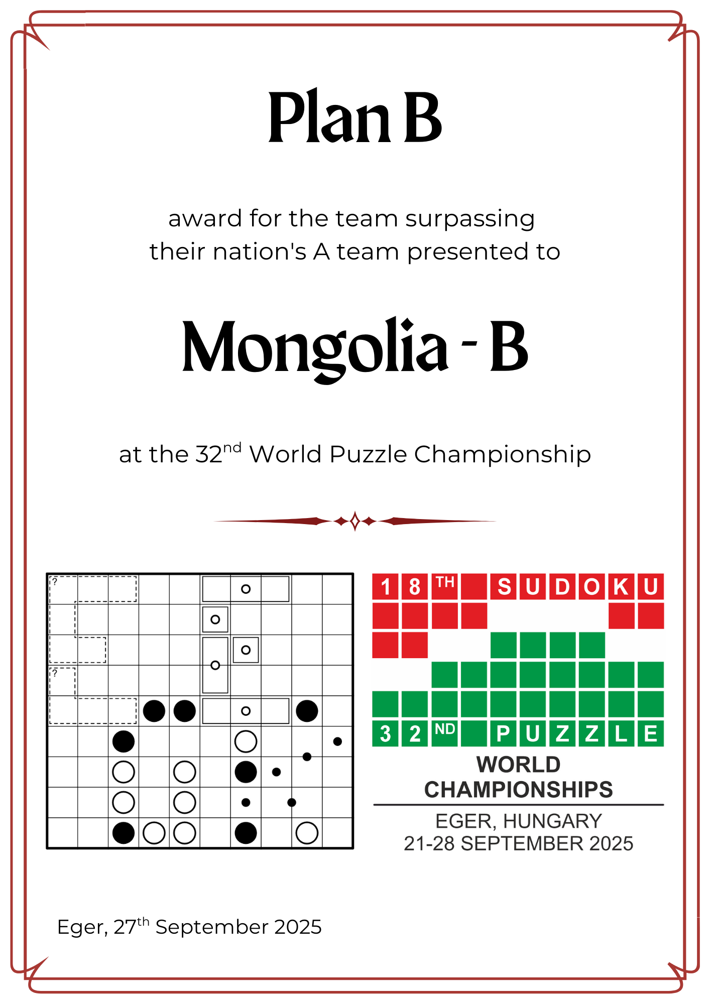

Slide 27
EASY PEASY

Slide 28
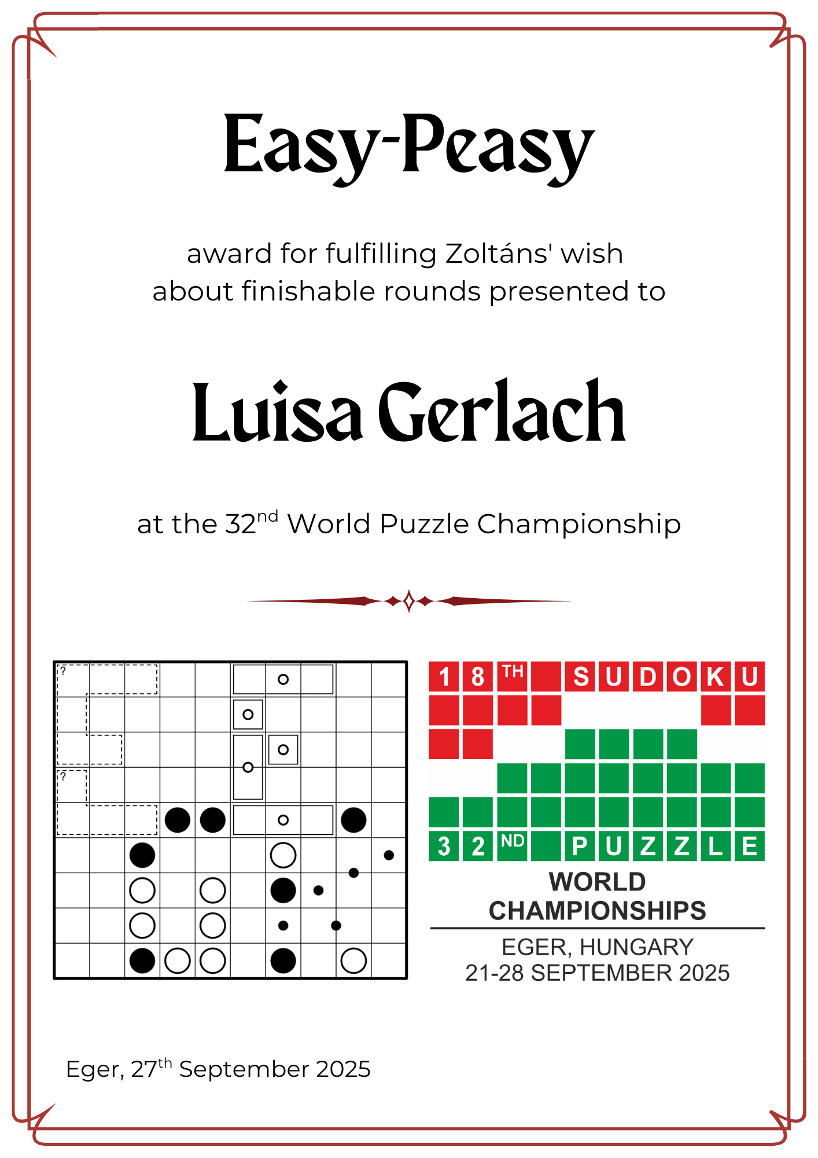

Slide 29
Luisa finished as 169th overall
Number of finishers:
Eger castle:51
Full loop: 43
Fish and Ships: 37
Hexa Hungary: 68

Slide 30
THE HOUSE ALWAYS WINS

Slide 31
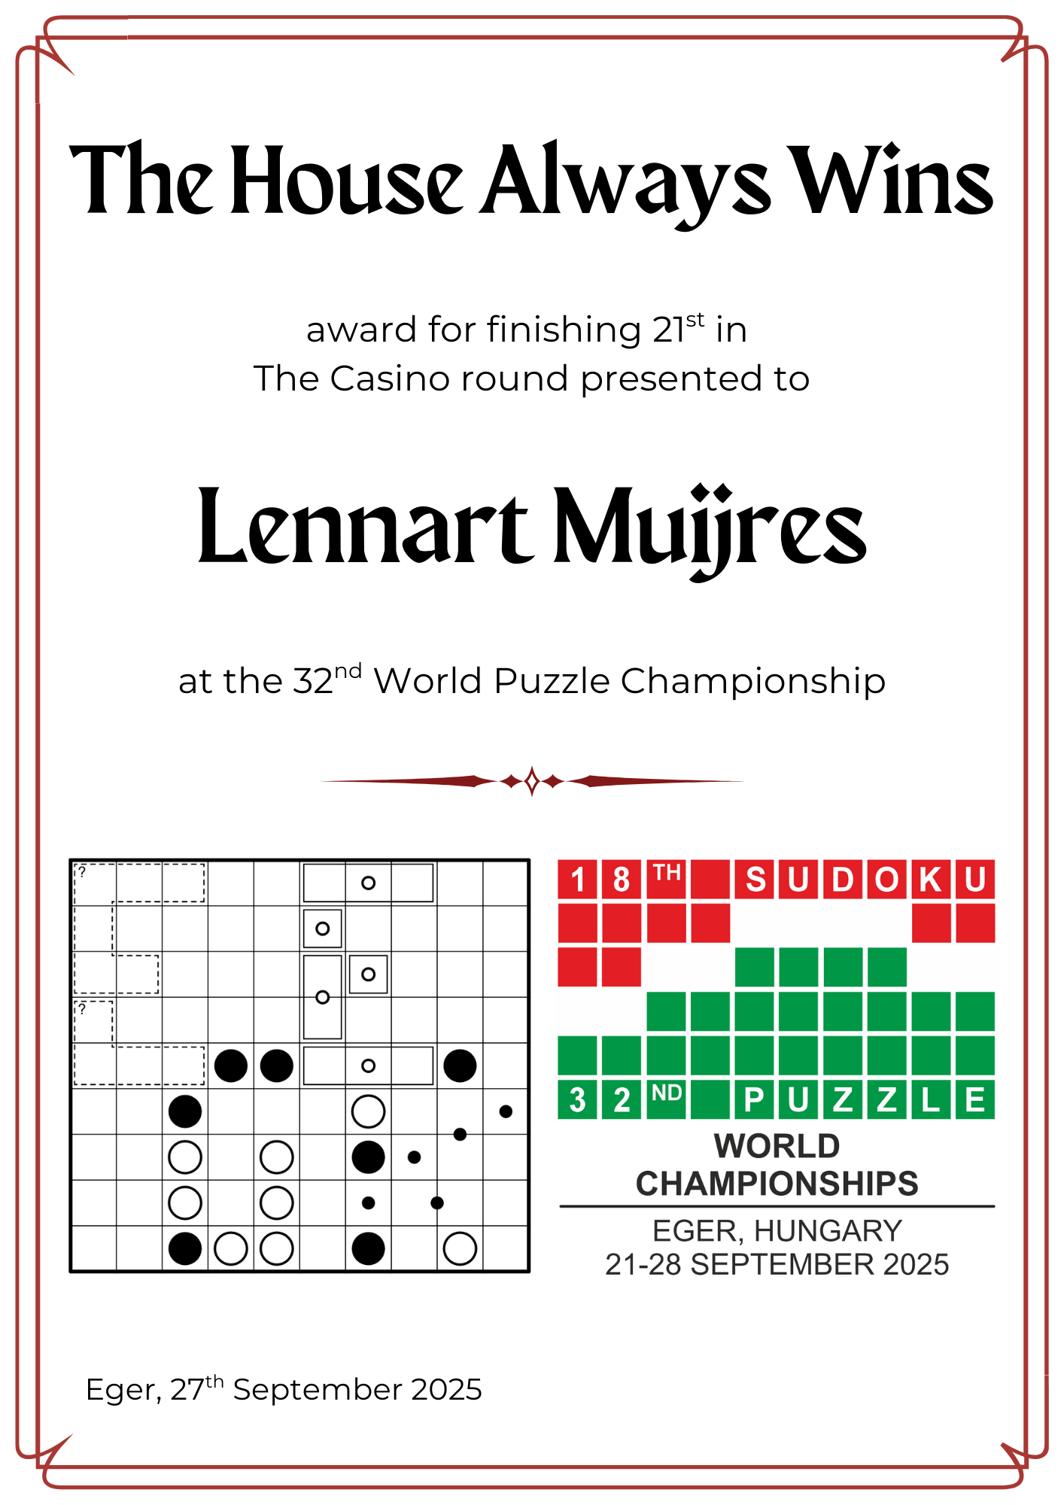

Slide 32
Battle reenactor

Slide 33
Eger siege 1552: HUN-A won
Eger siege 1596: TUR-A won
Eger castle round 2025:
HUN-A knight: Benedek Kovács 290
TUR-A knight: Salih Alan 590

Slide 34
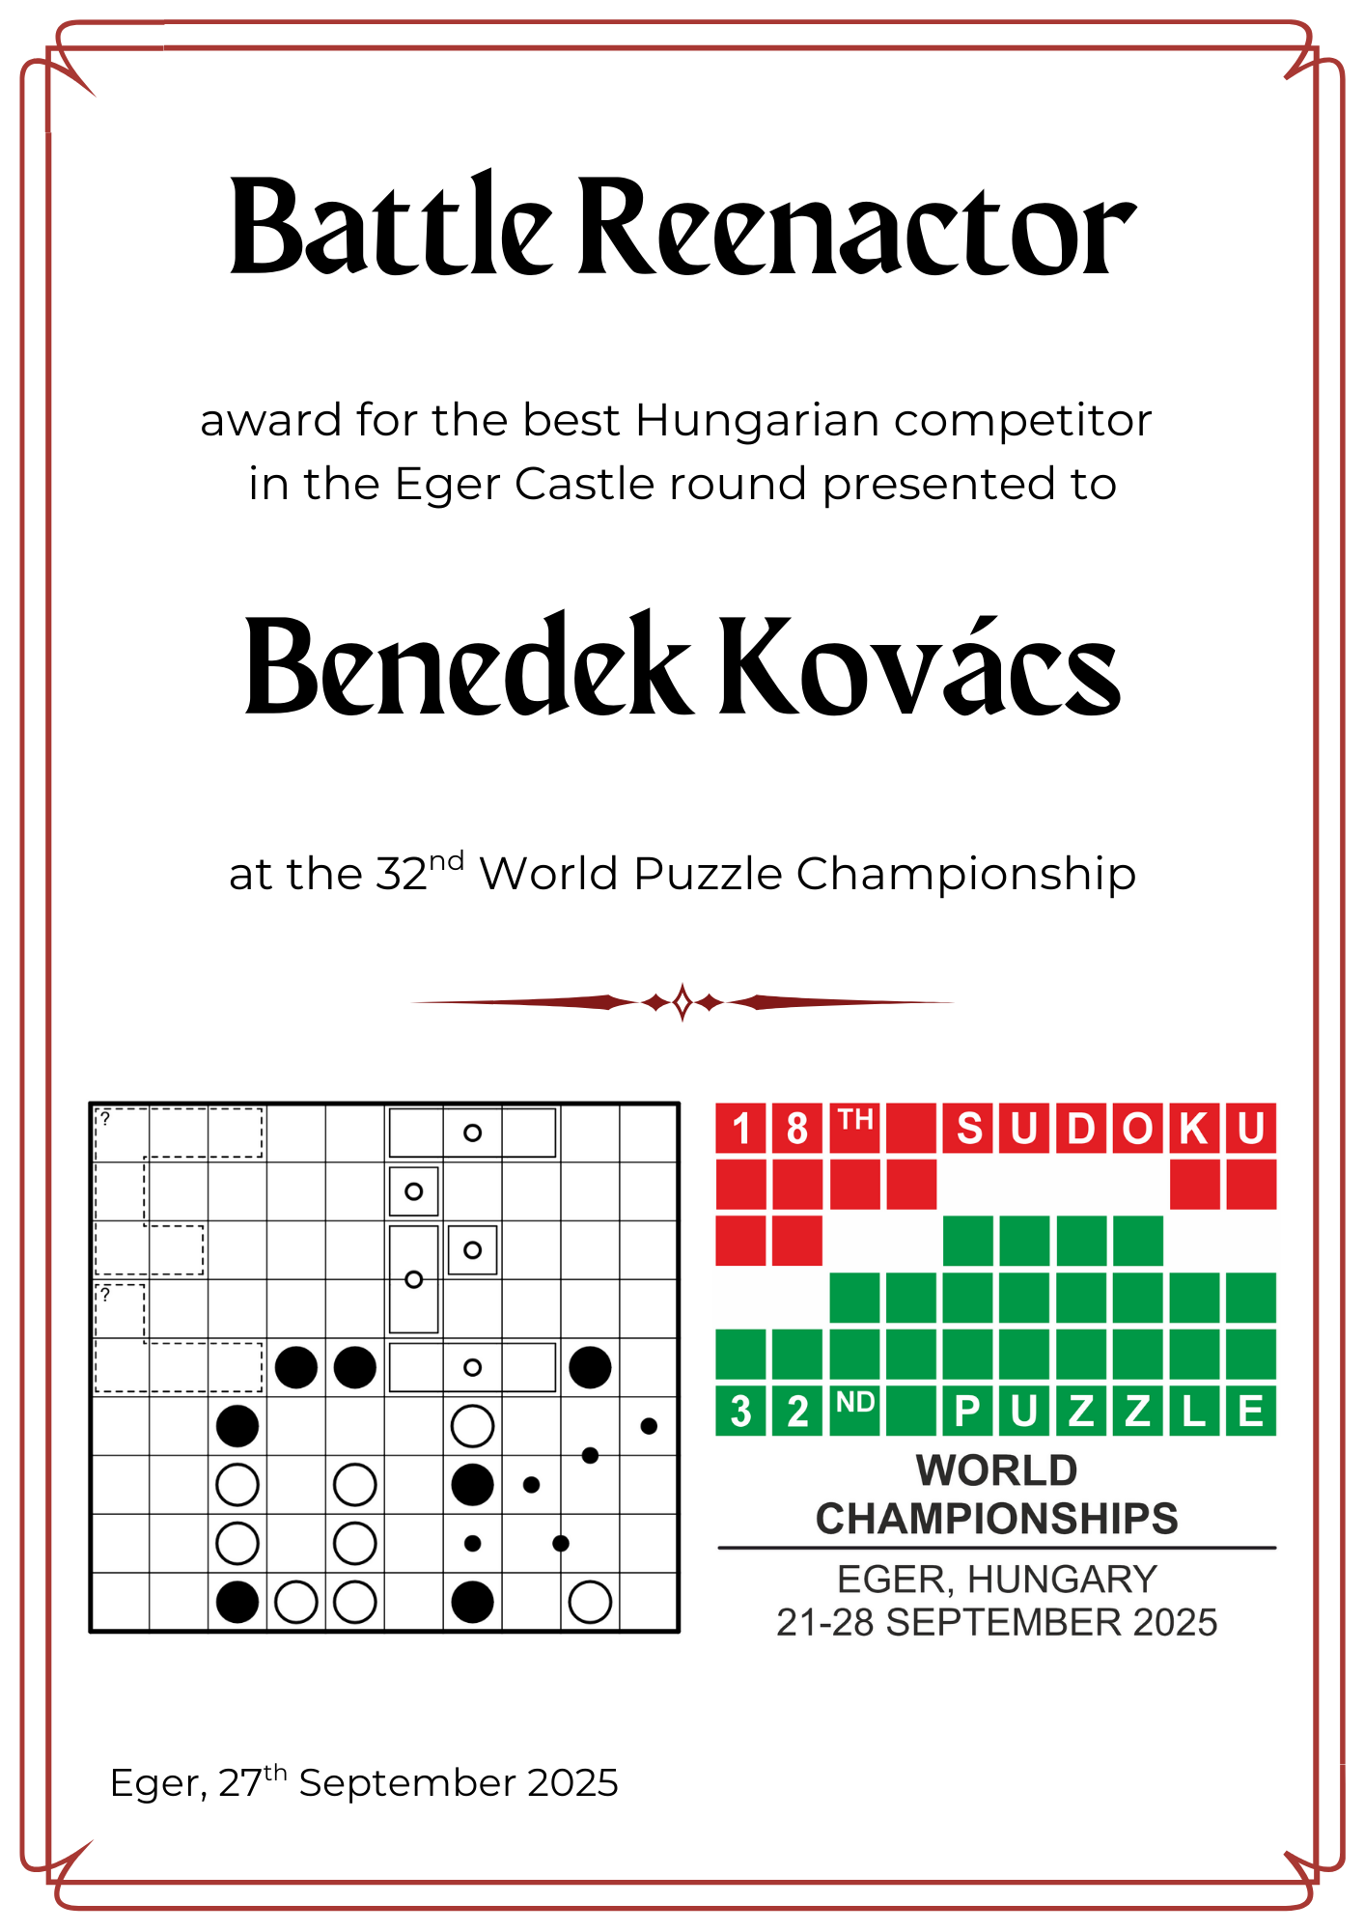

Slide 35
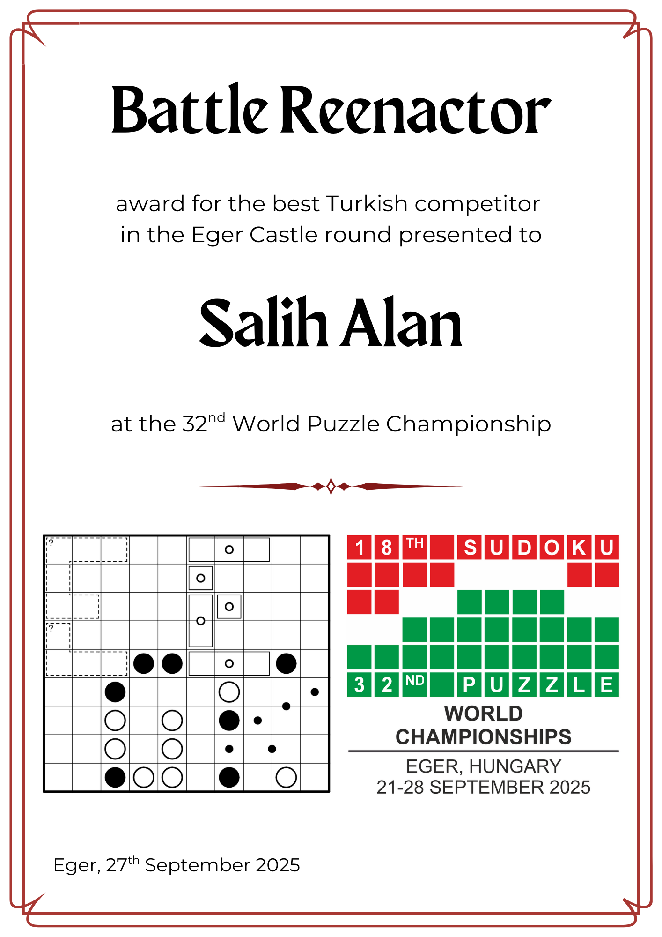

Slide 36
castaways

Slide 37
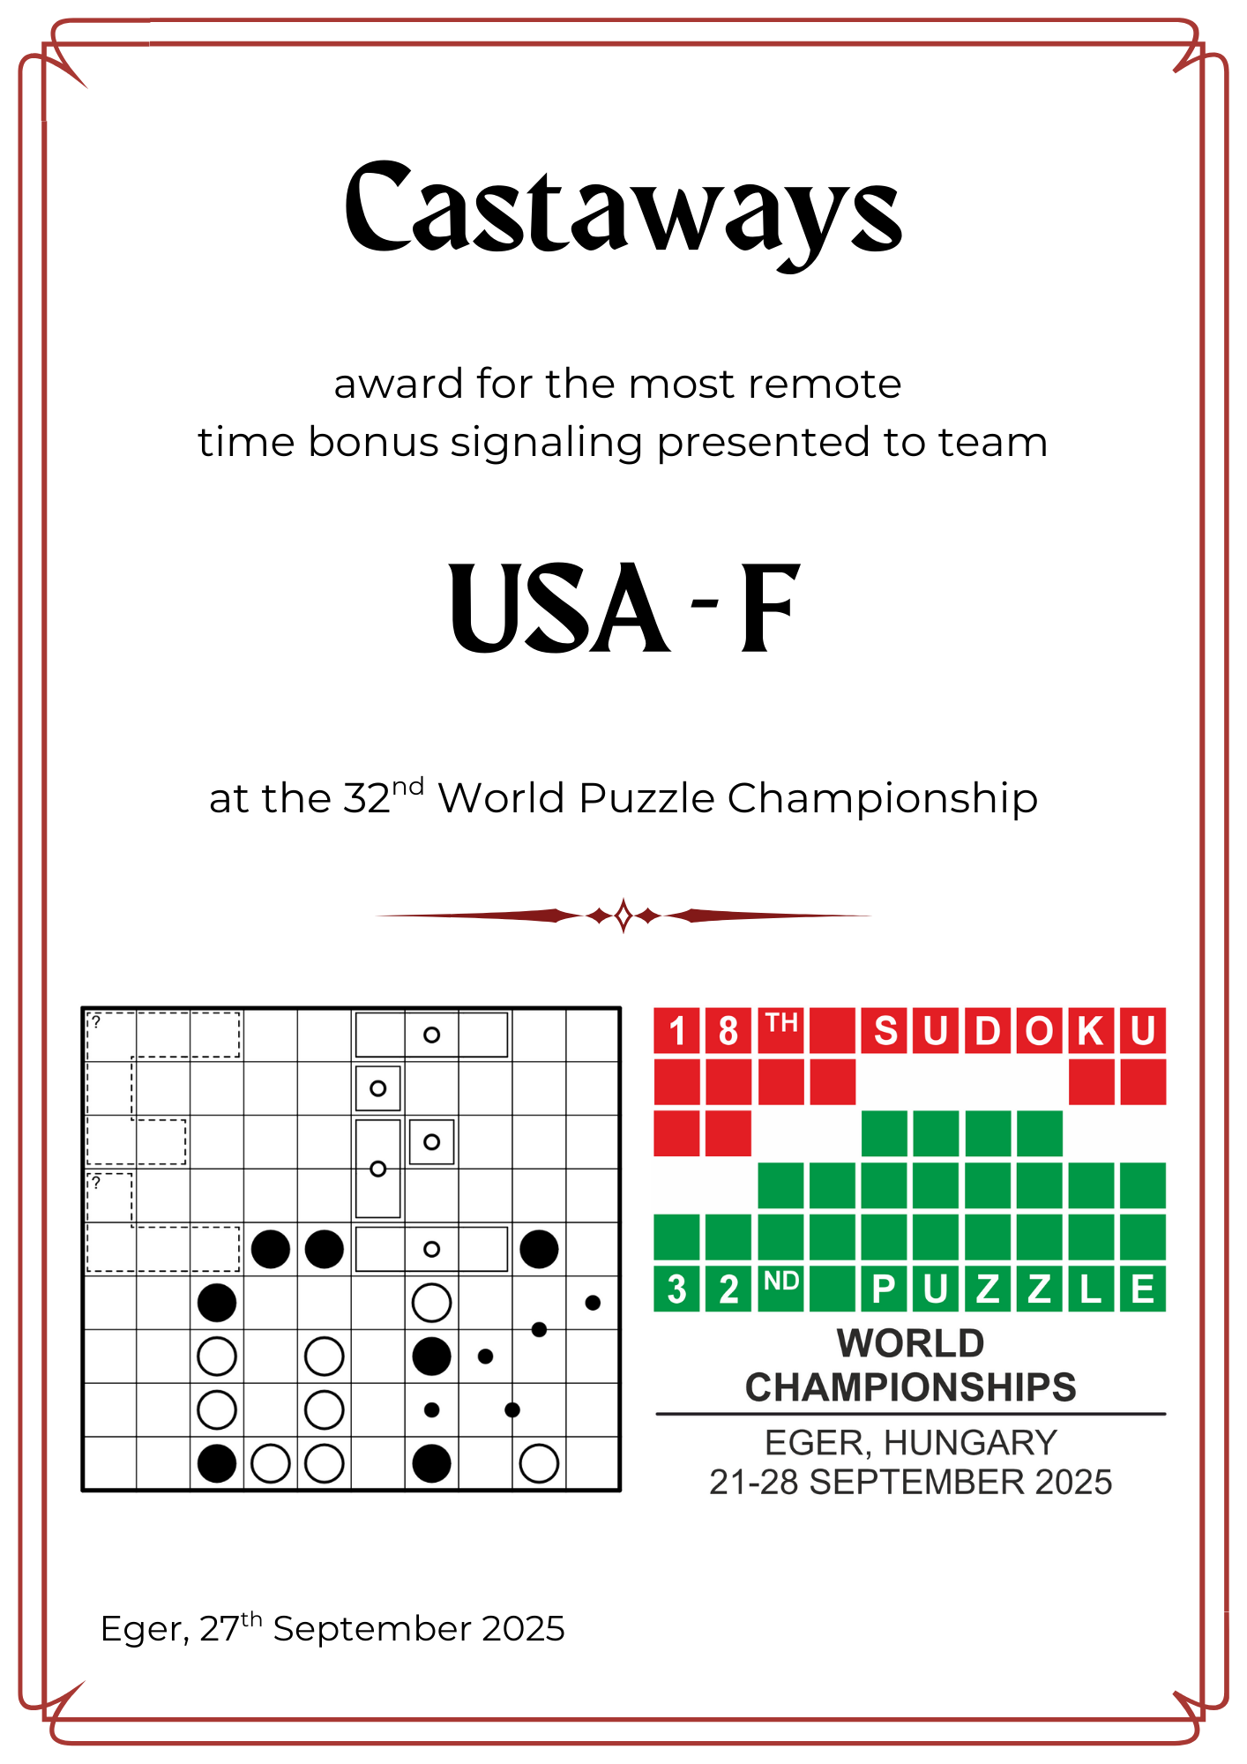

Slide 38
Made by stars

Slide 39
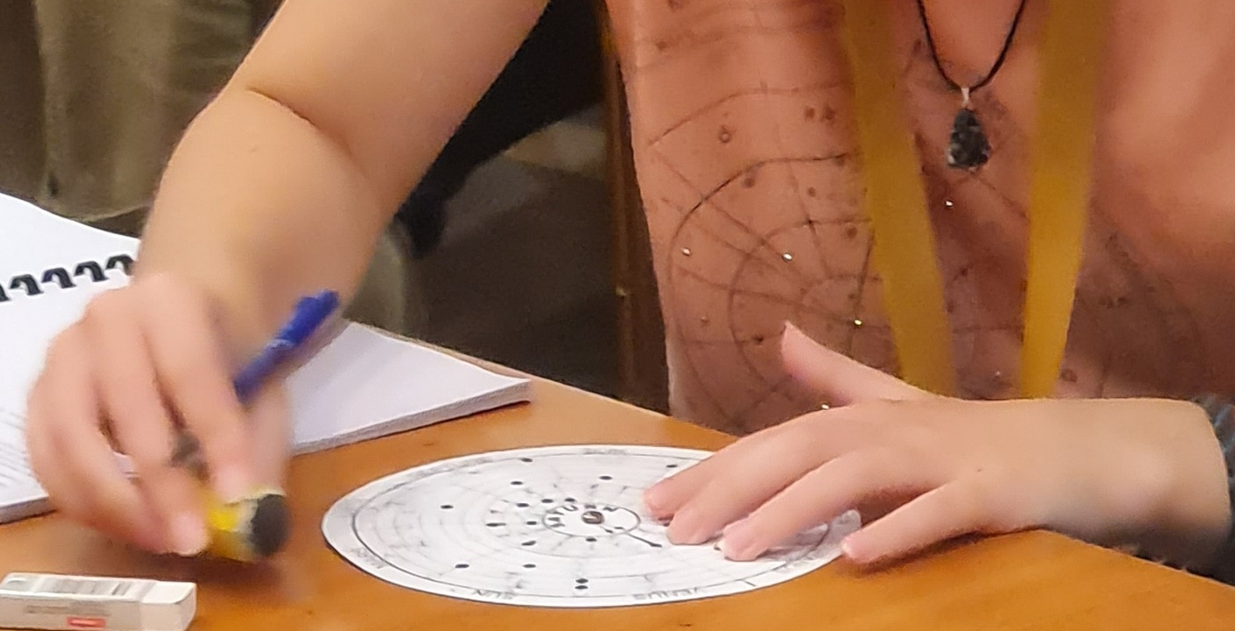

Slide 40
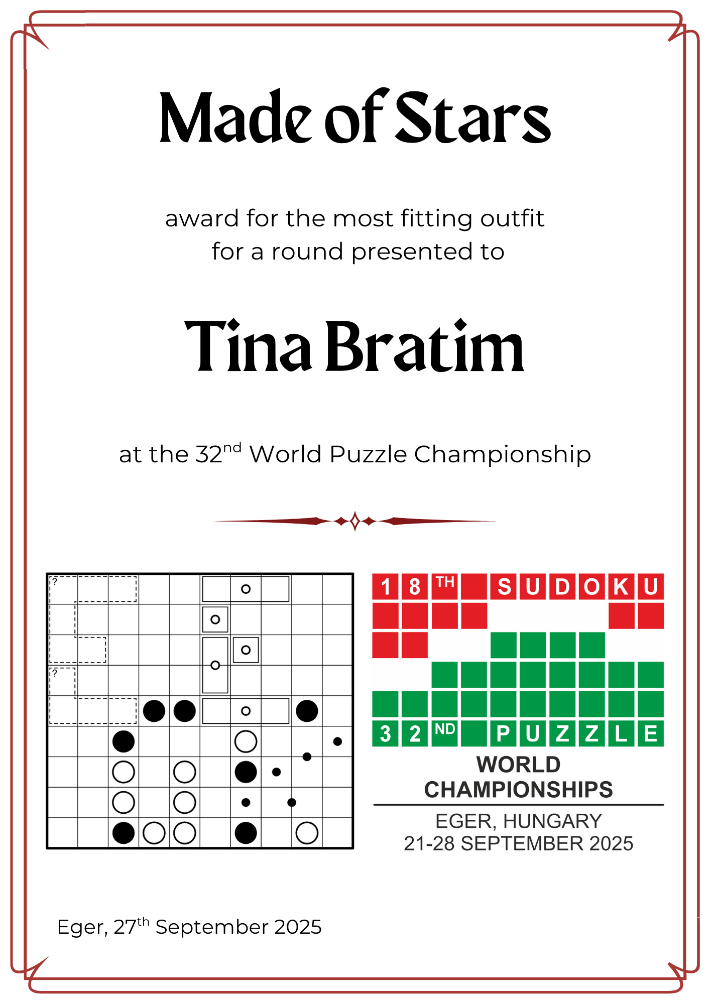

Slide 41
Expansion pack

Slide 42
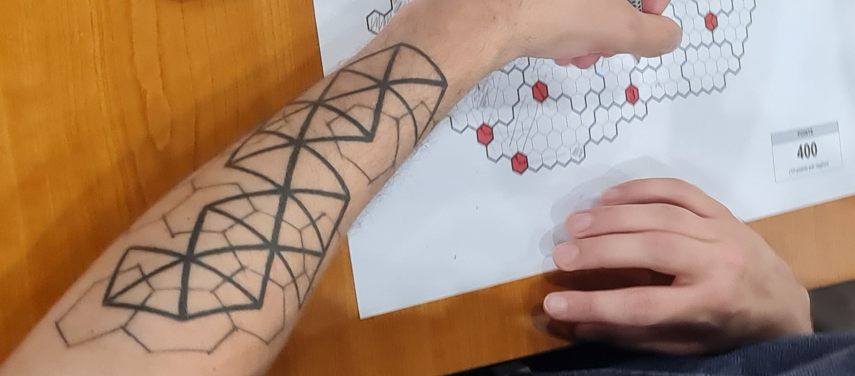

Slide 43
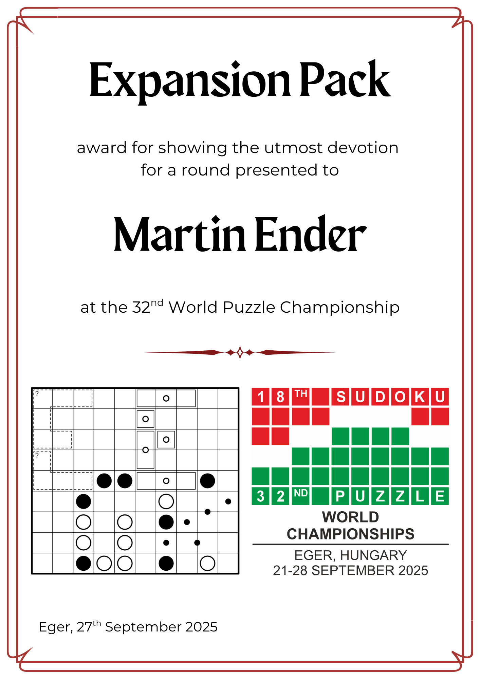

Slide 44
PATREON SUPPORTER

Slide 45
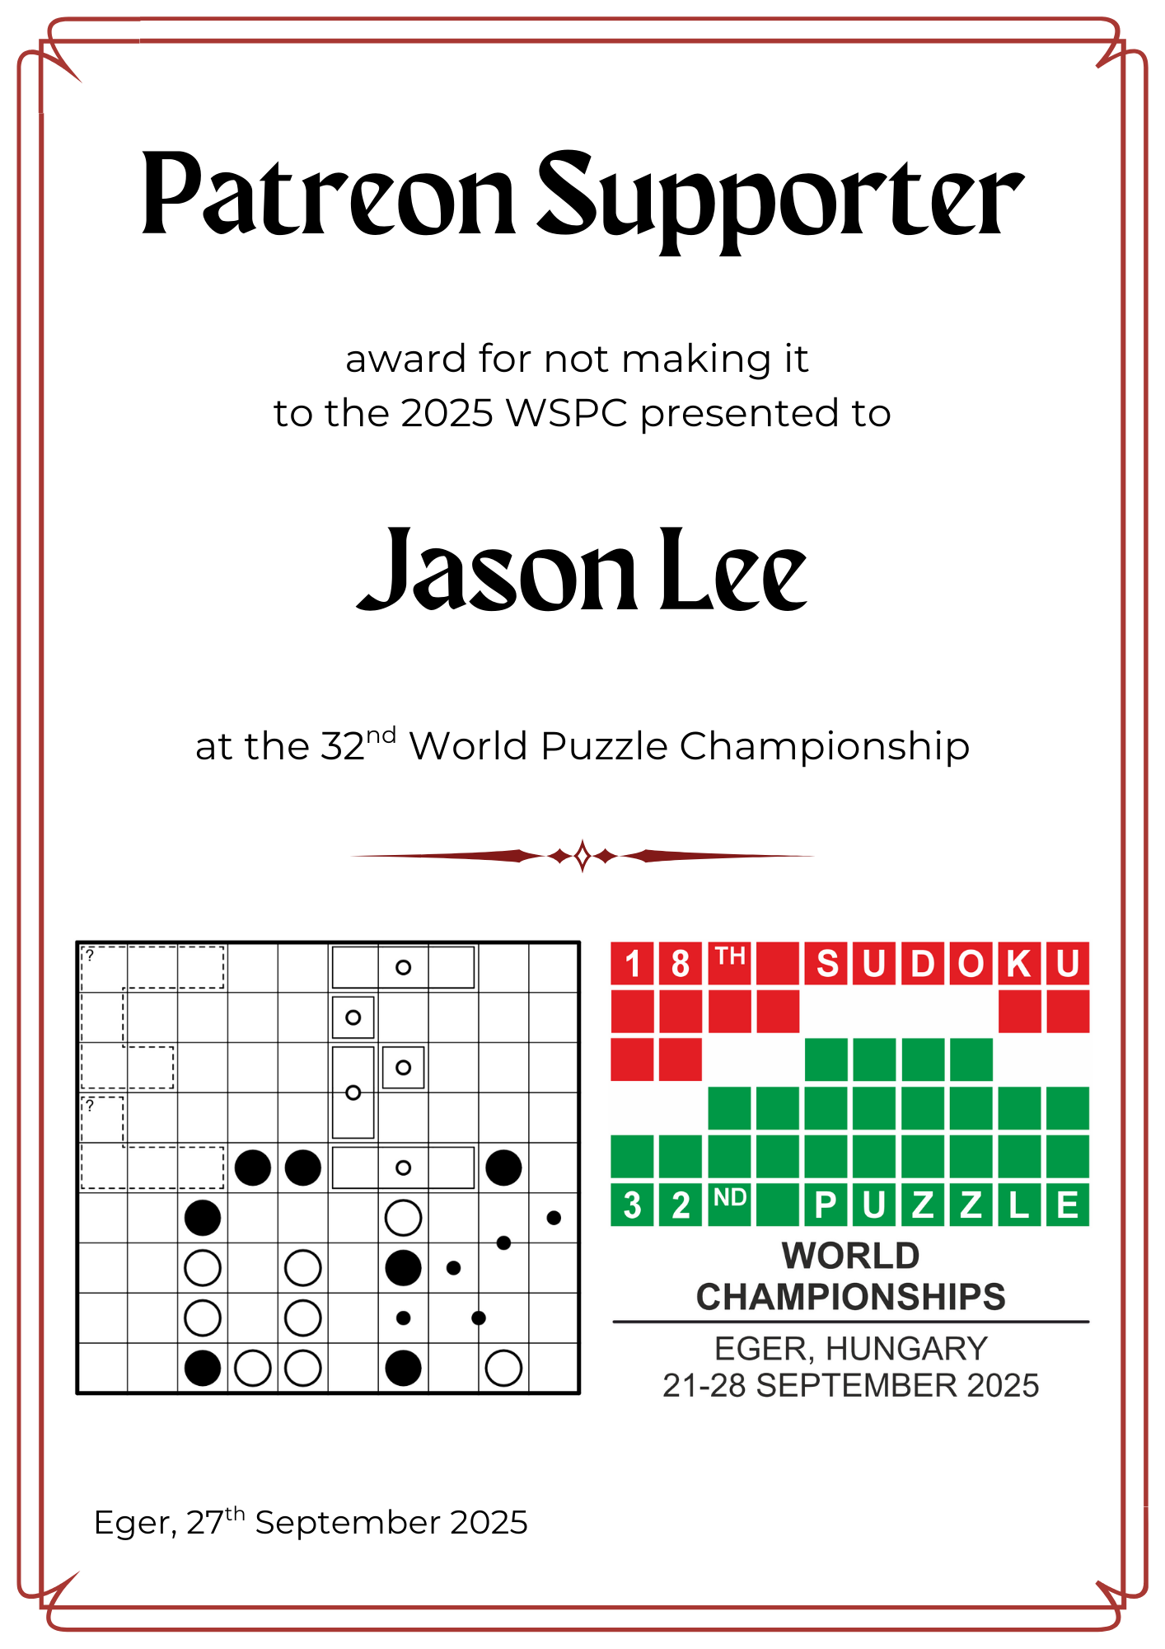

Slide 46
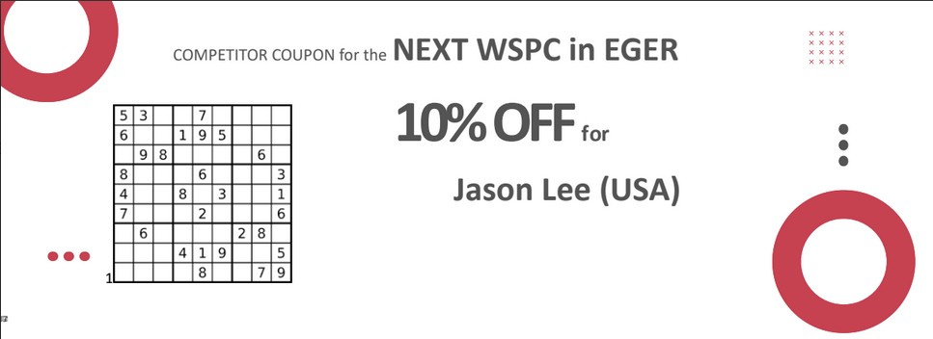

Slide 47
The revenant

Slide 48
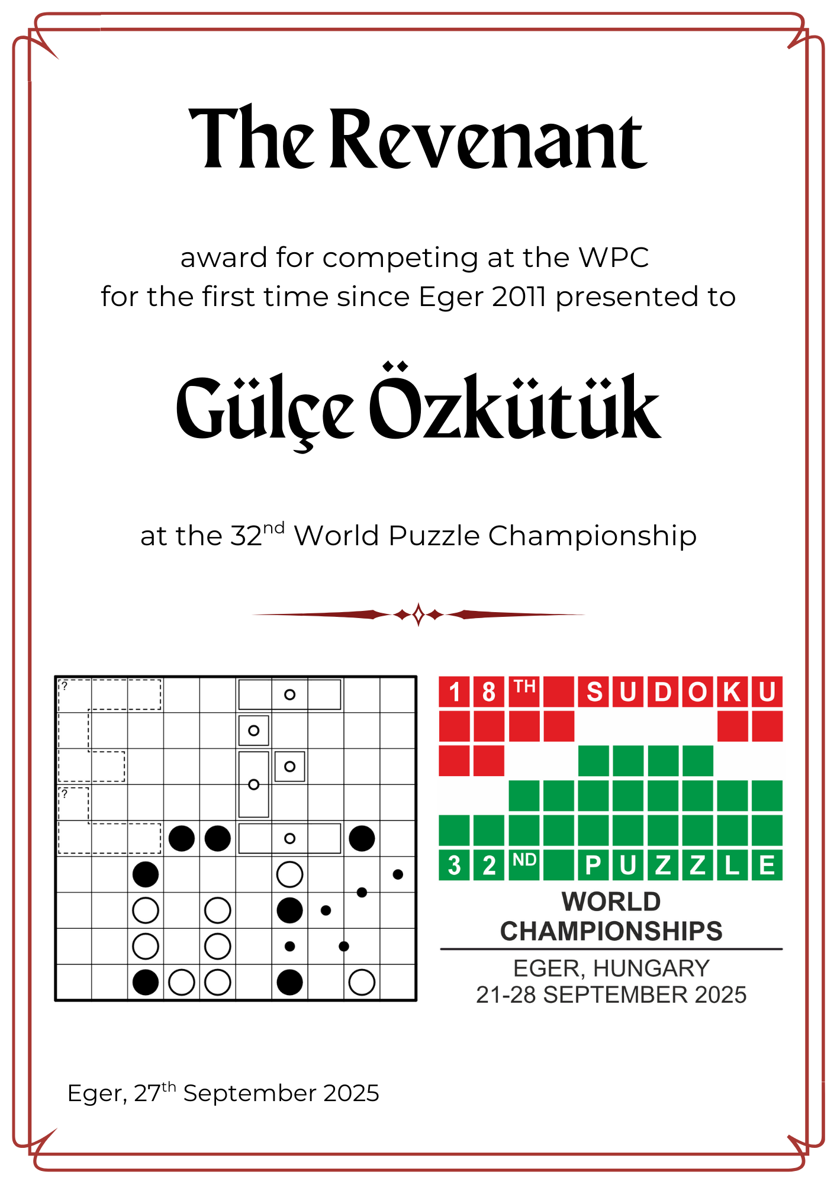

Slide 49
MORAL COMPASS

Slide 50
200 self-forfeited points

Slide 51
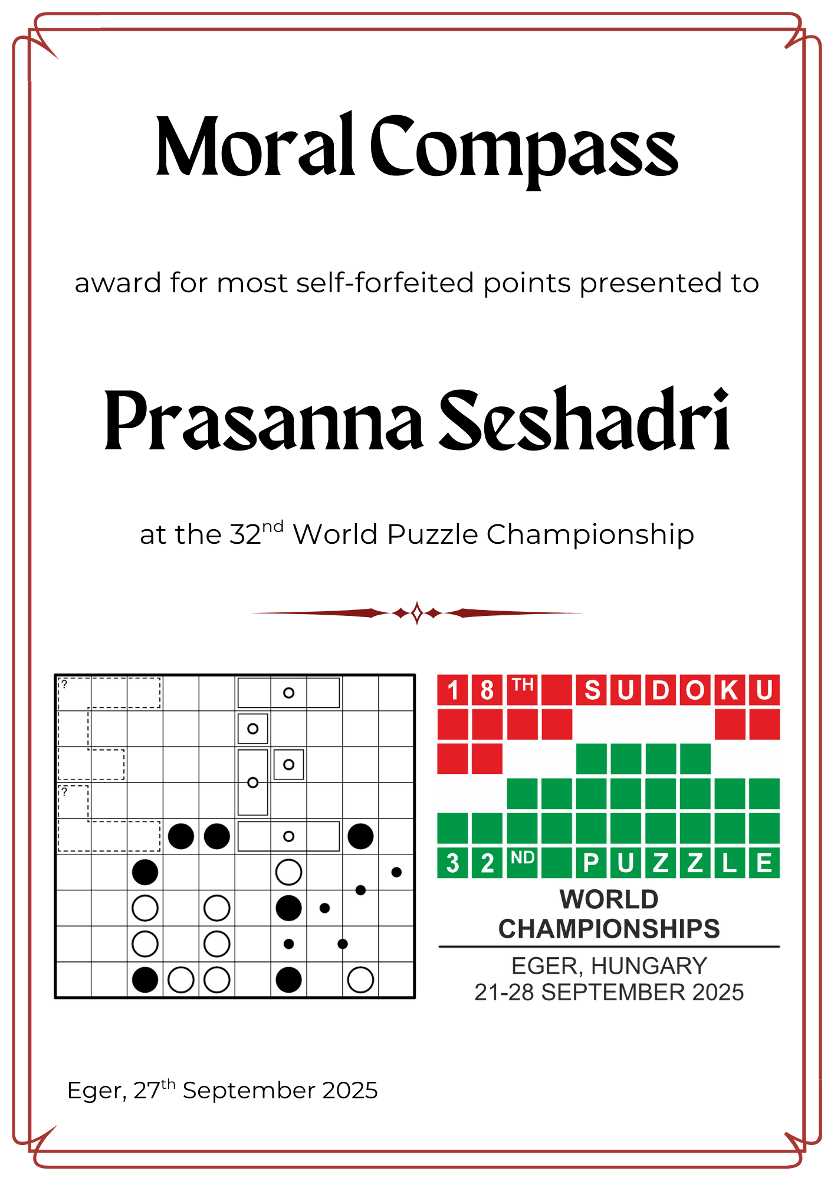

Slide 52
NICE TRY

Slide 53
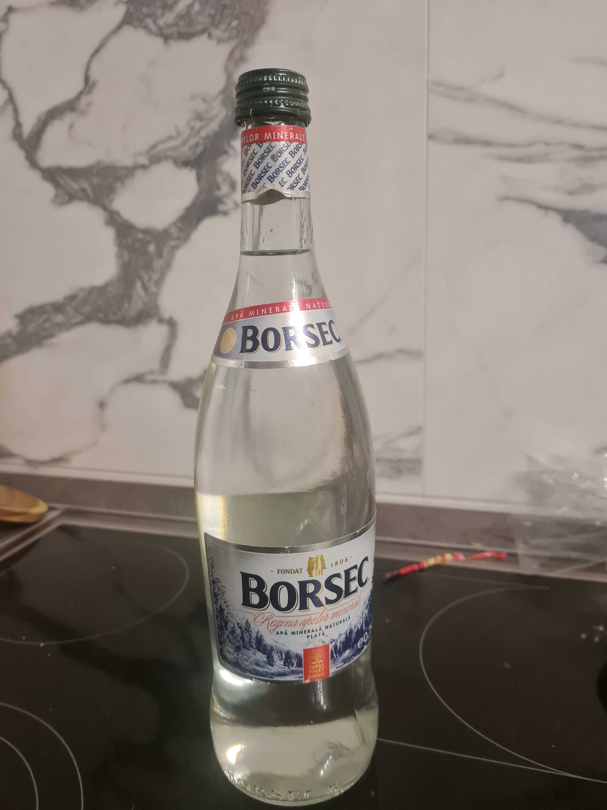
PALINKA

Slide 54
