Slide 1
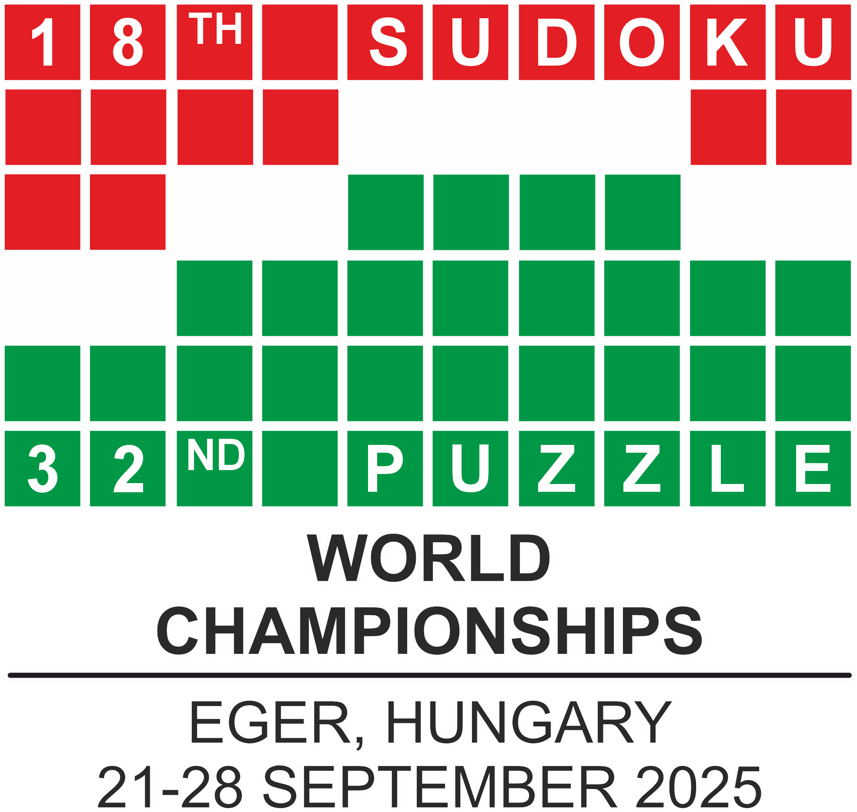
POP-ROCK QUIZ

Slide 2

JASON V. ZUFFRANIERI

Slide 3
Award CEREMONY of hidden categories

Slide 4
DOYEN

Slide 5
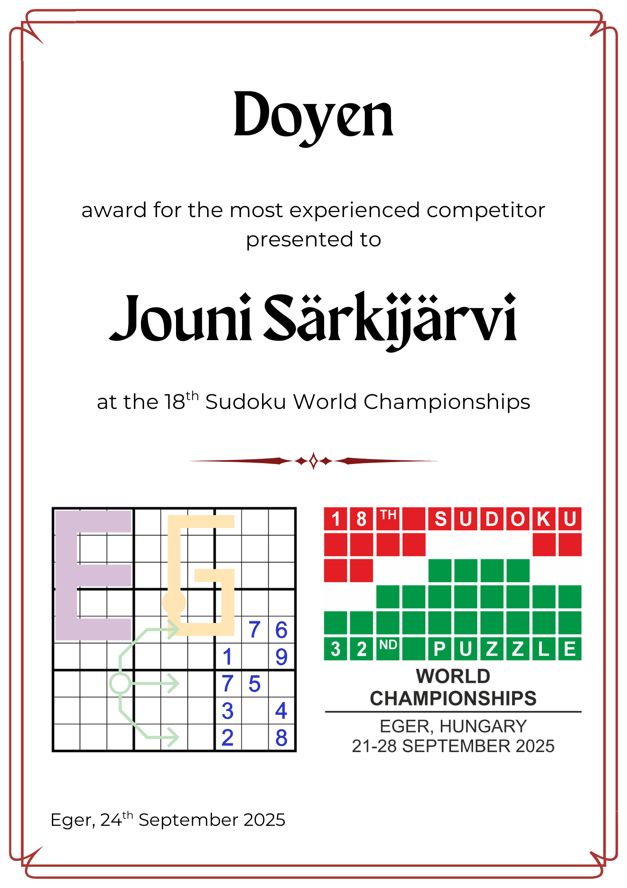

Slide 6
BENJAMIN

Slide 7
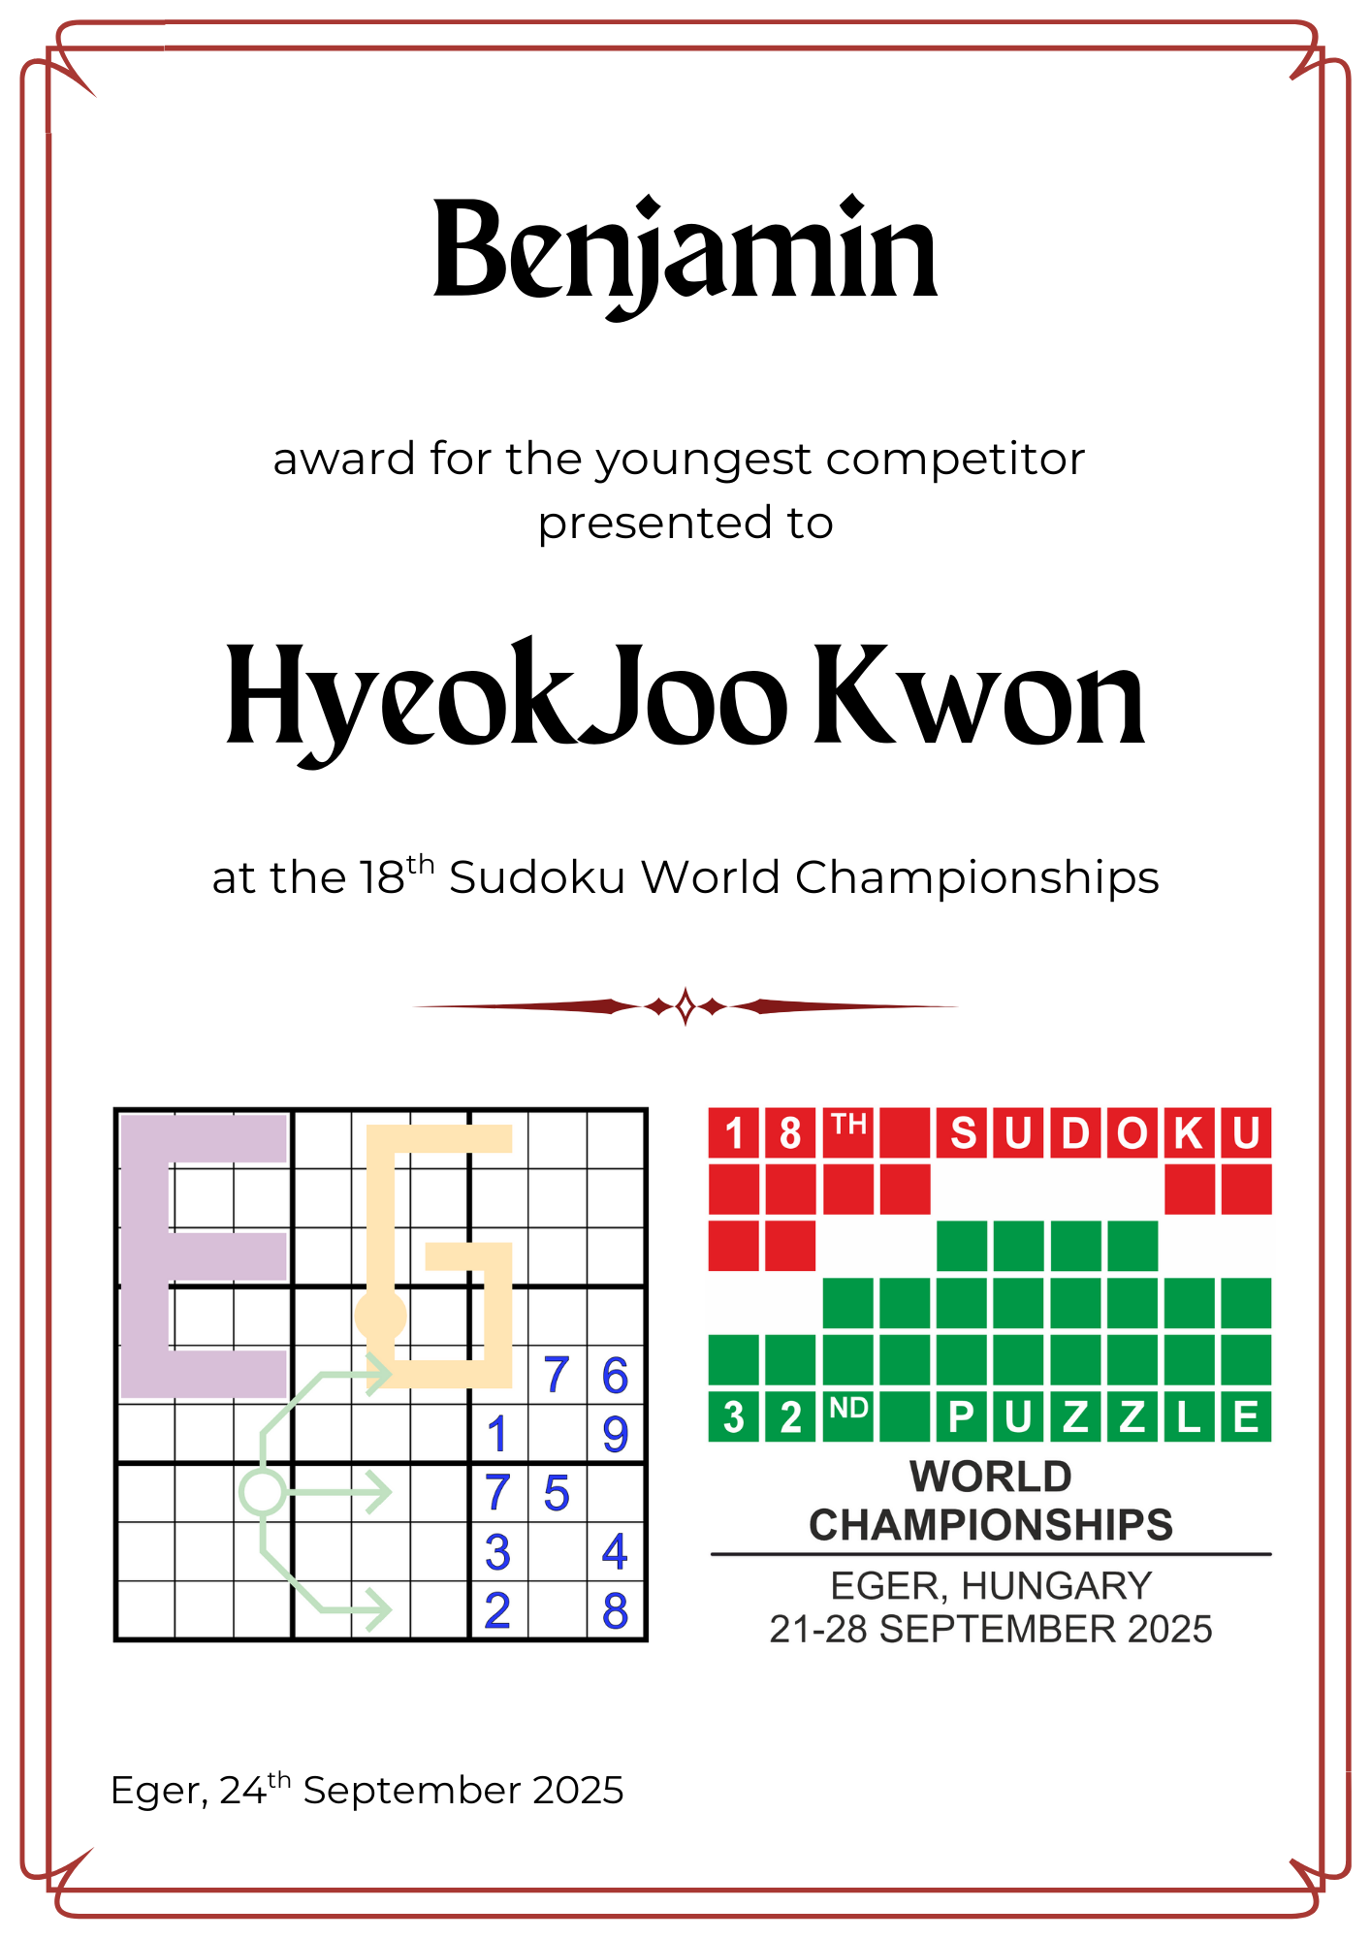

Slide 8
SELF-FULFILLING PROPHECY

Slide 9
COMPETITOR ID = 2405
TOTAL SCORE = 2409

Slide 10
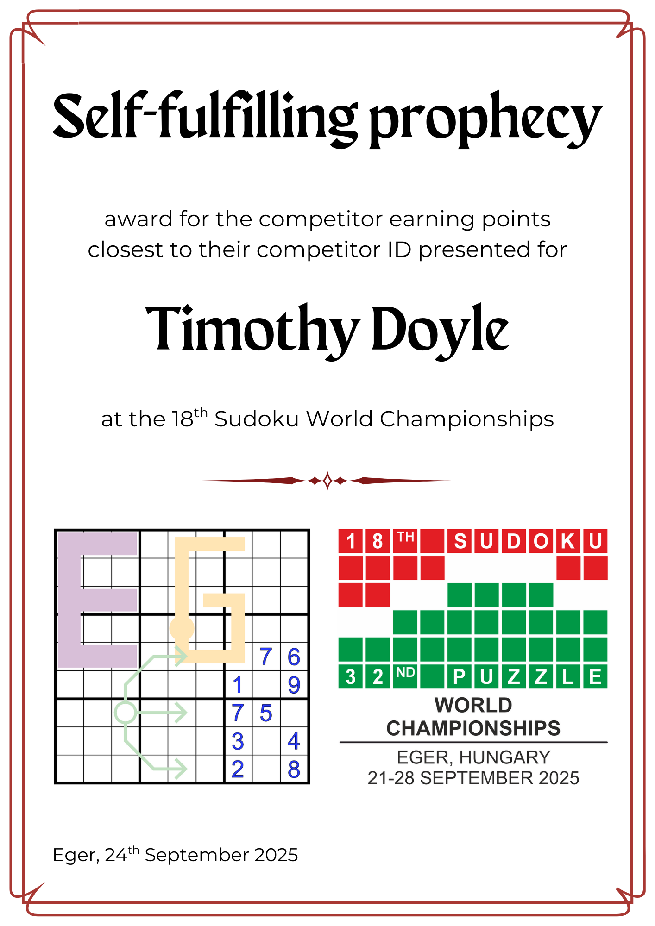

Slide 11
TWO PEAS IN A POD

Slide 12
After 10 individual round they could not decide who is better
3165 vs 3165

Slide 13
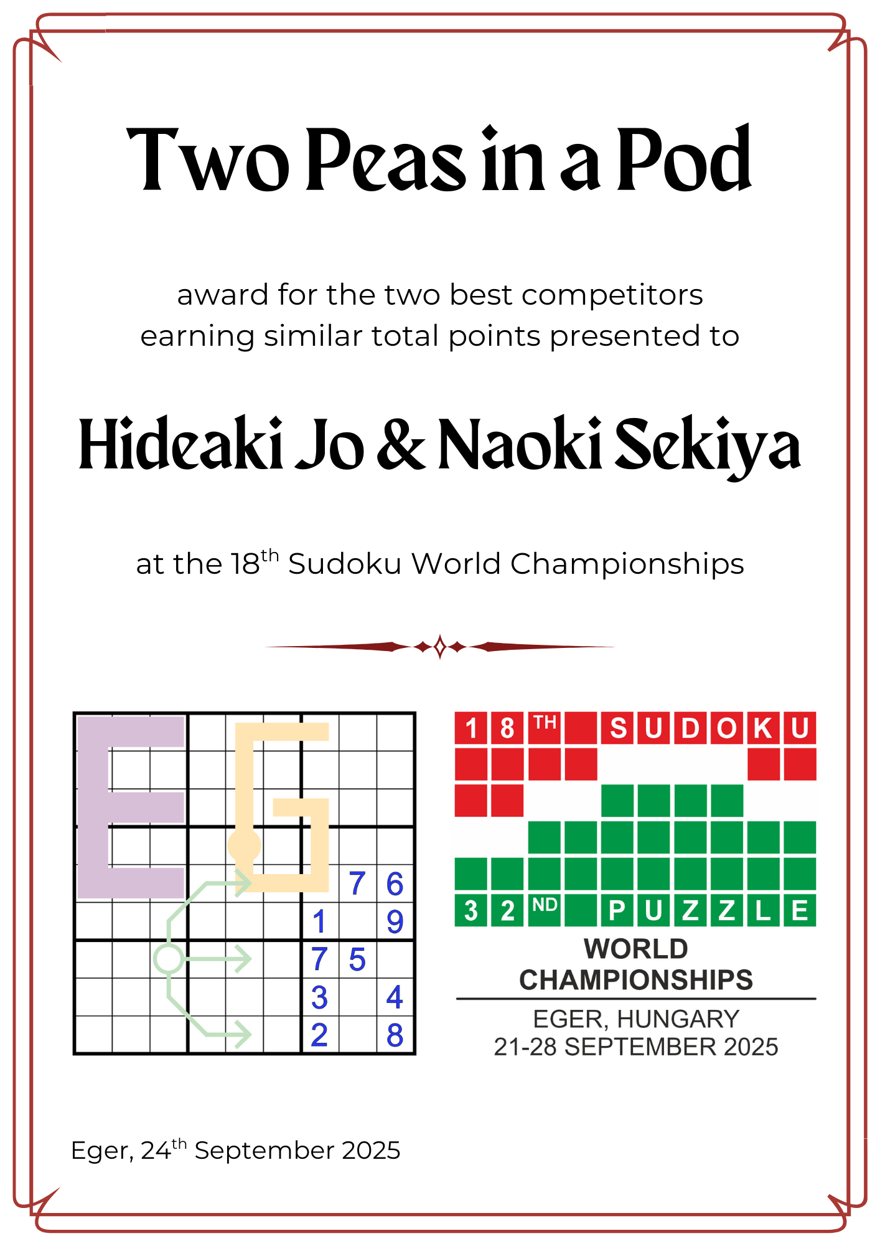

Slide 14
NOT LEFT BEHIND

Slide 15
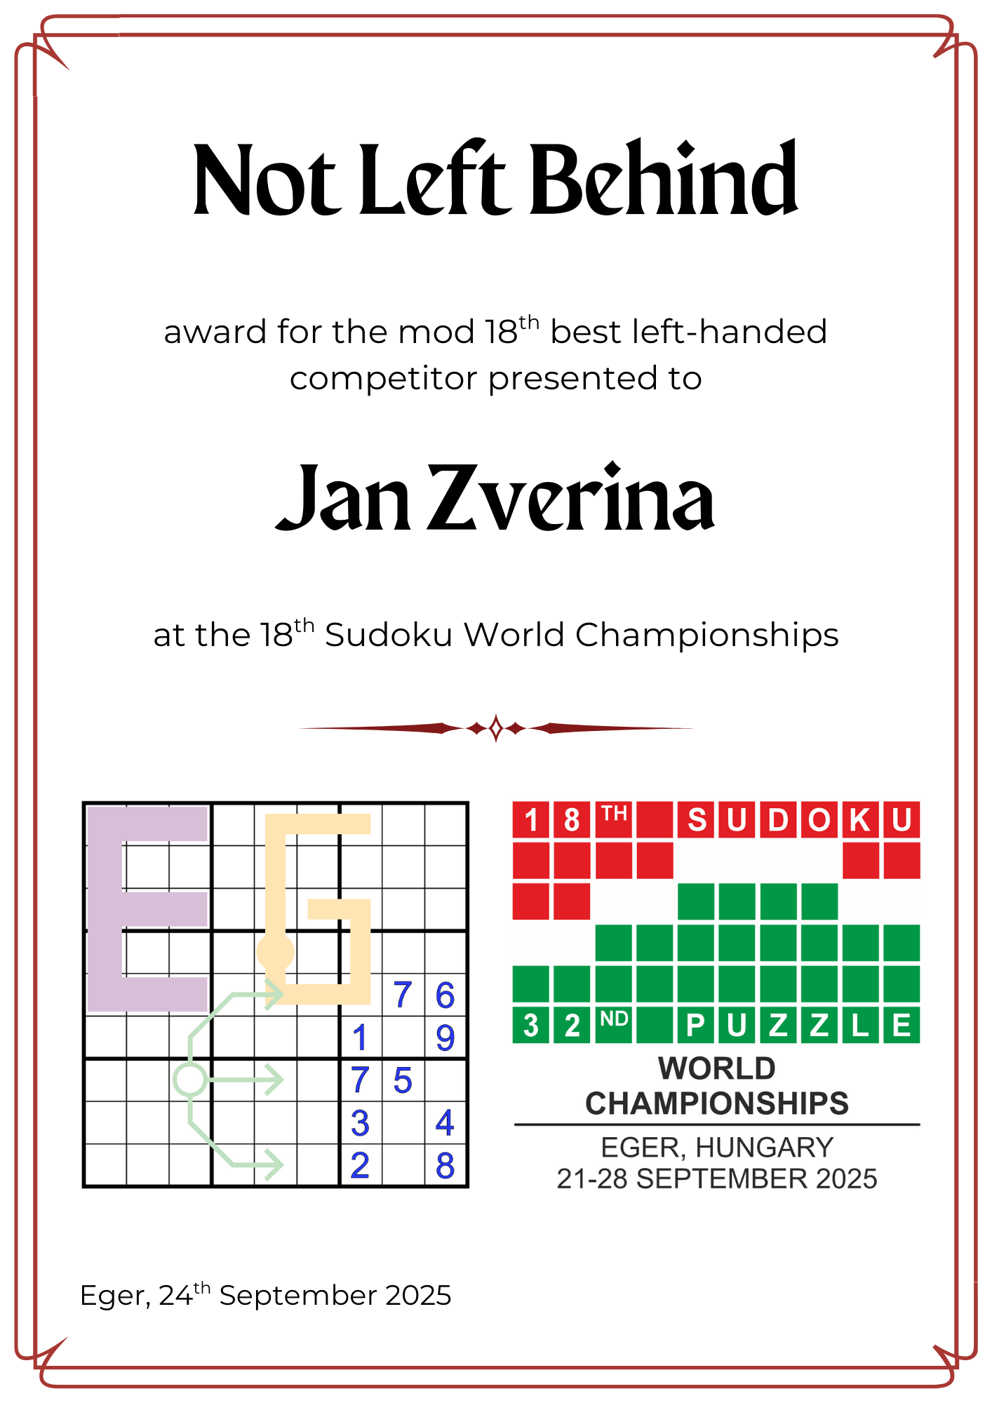

Slide 16
Vital statistics of WSC 2025
Left-handed competitors:
16/252 (6,35%)
Competitors solving in glasses:
143/252 (56,75%)
Lady competitors:
78/252 (30,95%)
Competitors present in both 2011 and 2025 WSC:
38 (15,08%)

Slide 17
LIKE CLOCKWORK

Slide 18
Jörg Zentgraf 1744
Sara Terveer 1720
Larissa Rudolph 1622
Susanne Günther 1615

Slide 19
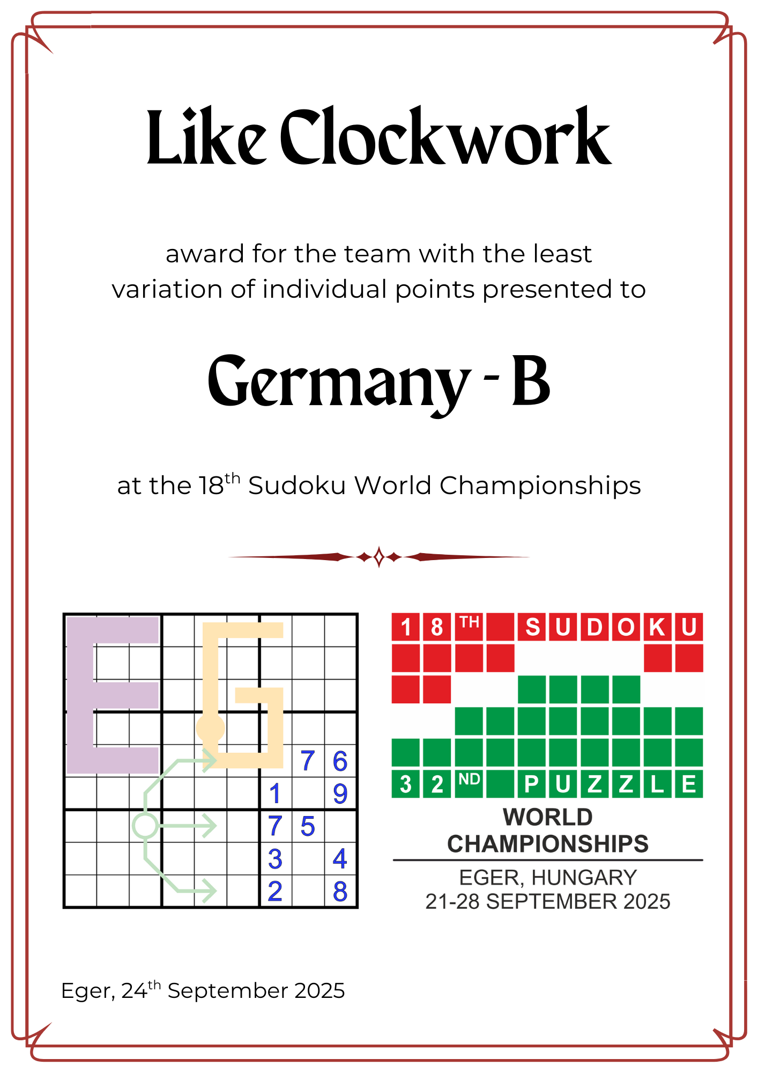

Slide 20
PEN PALS

Slide 21
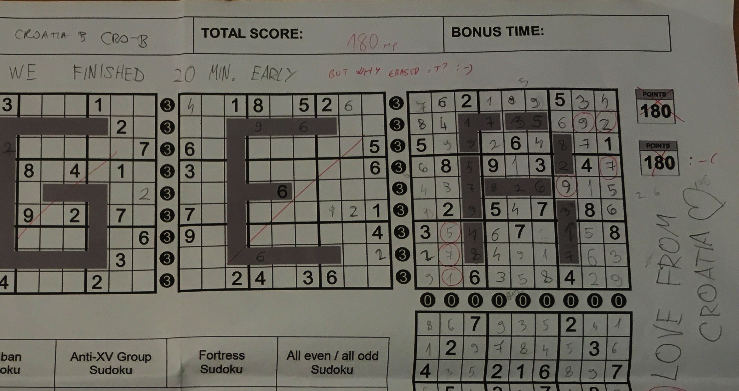

Slide 22
Lovro Đerek
Ana Markoljević
David Blekić
Karla Grgić

Slide 23
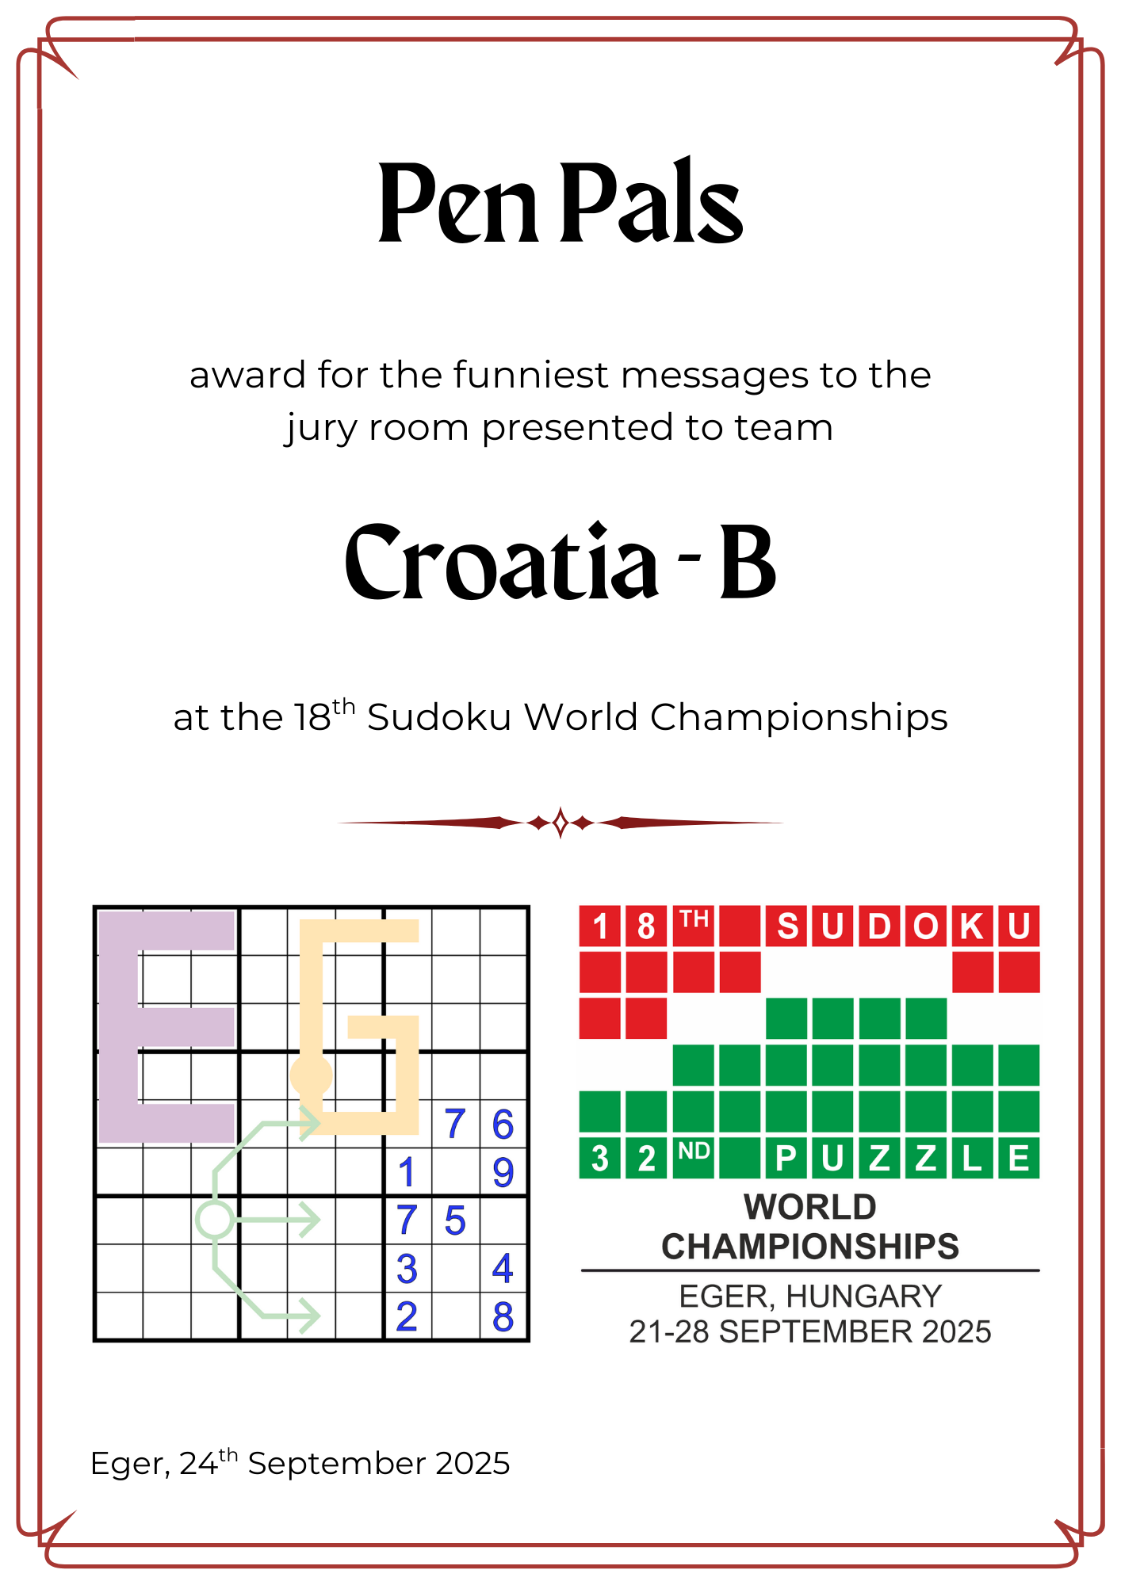

Slide 24
KILLER SUDOKU OUTFIT

Slide 25
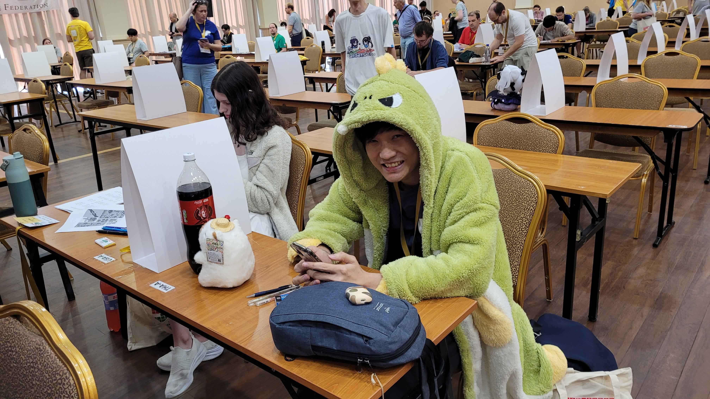

Slide 26
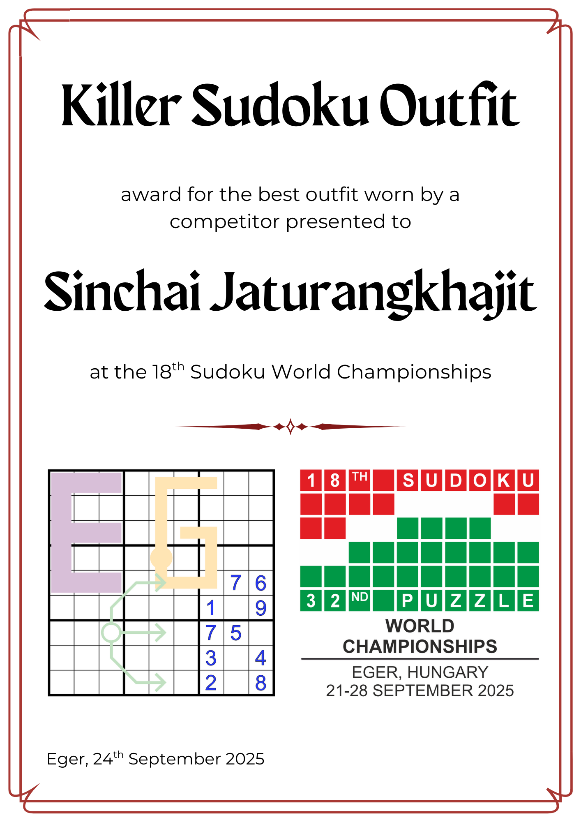

Slide 27
HEAD OF THE JURY APPRECIATION COMMITEE

Slide 28
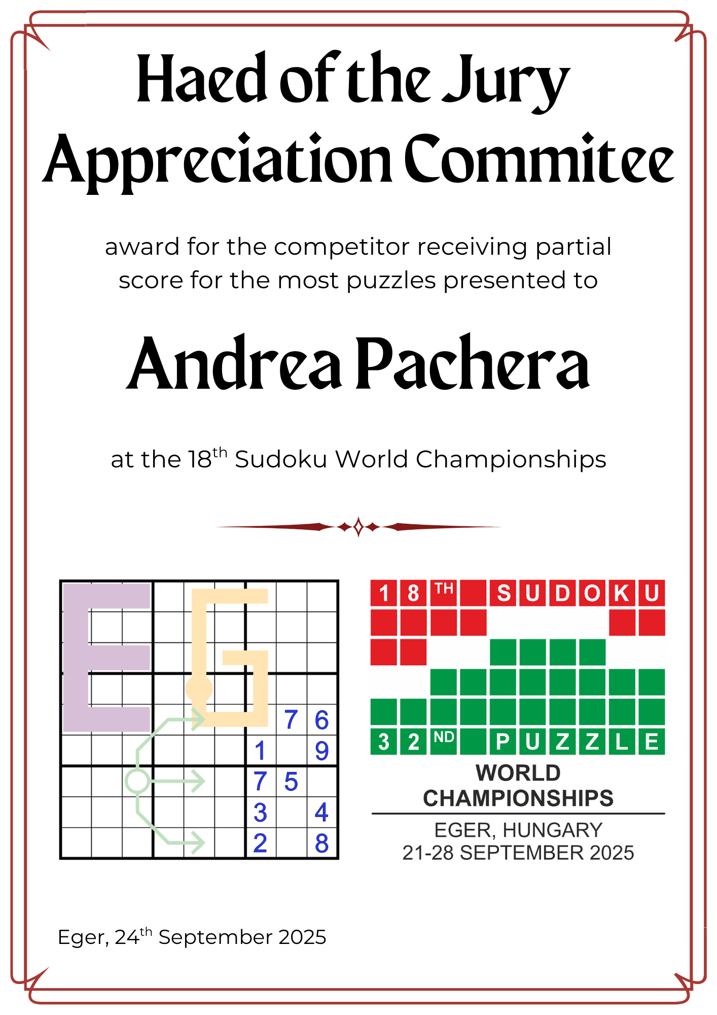

Slide 29
6 puzzles
55+50+65+20+45+70
305 -> 183 points saved

Slide 30
GORGEOUS GRID

Slide 31
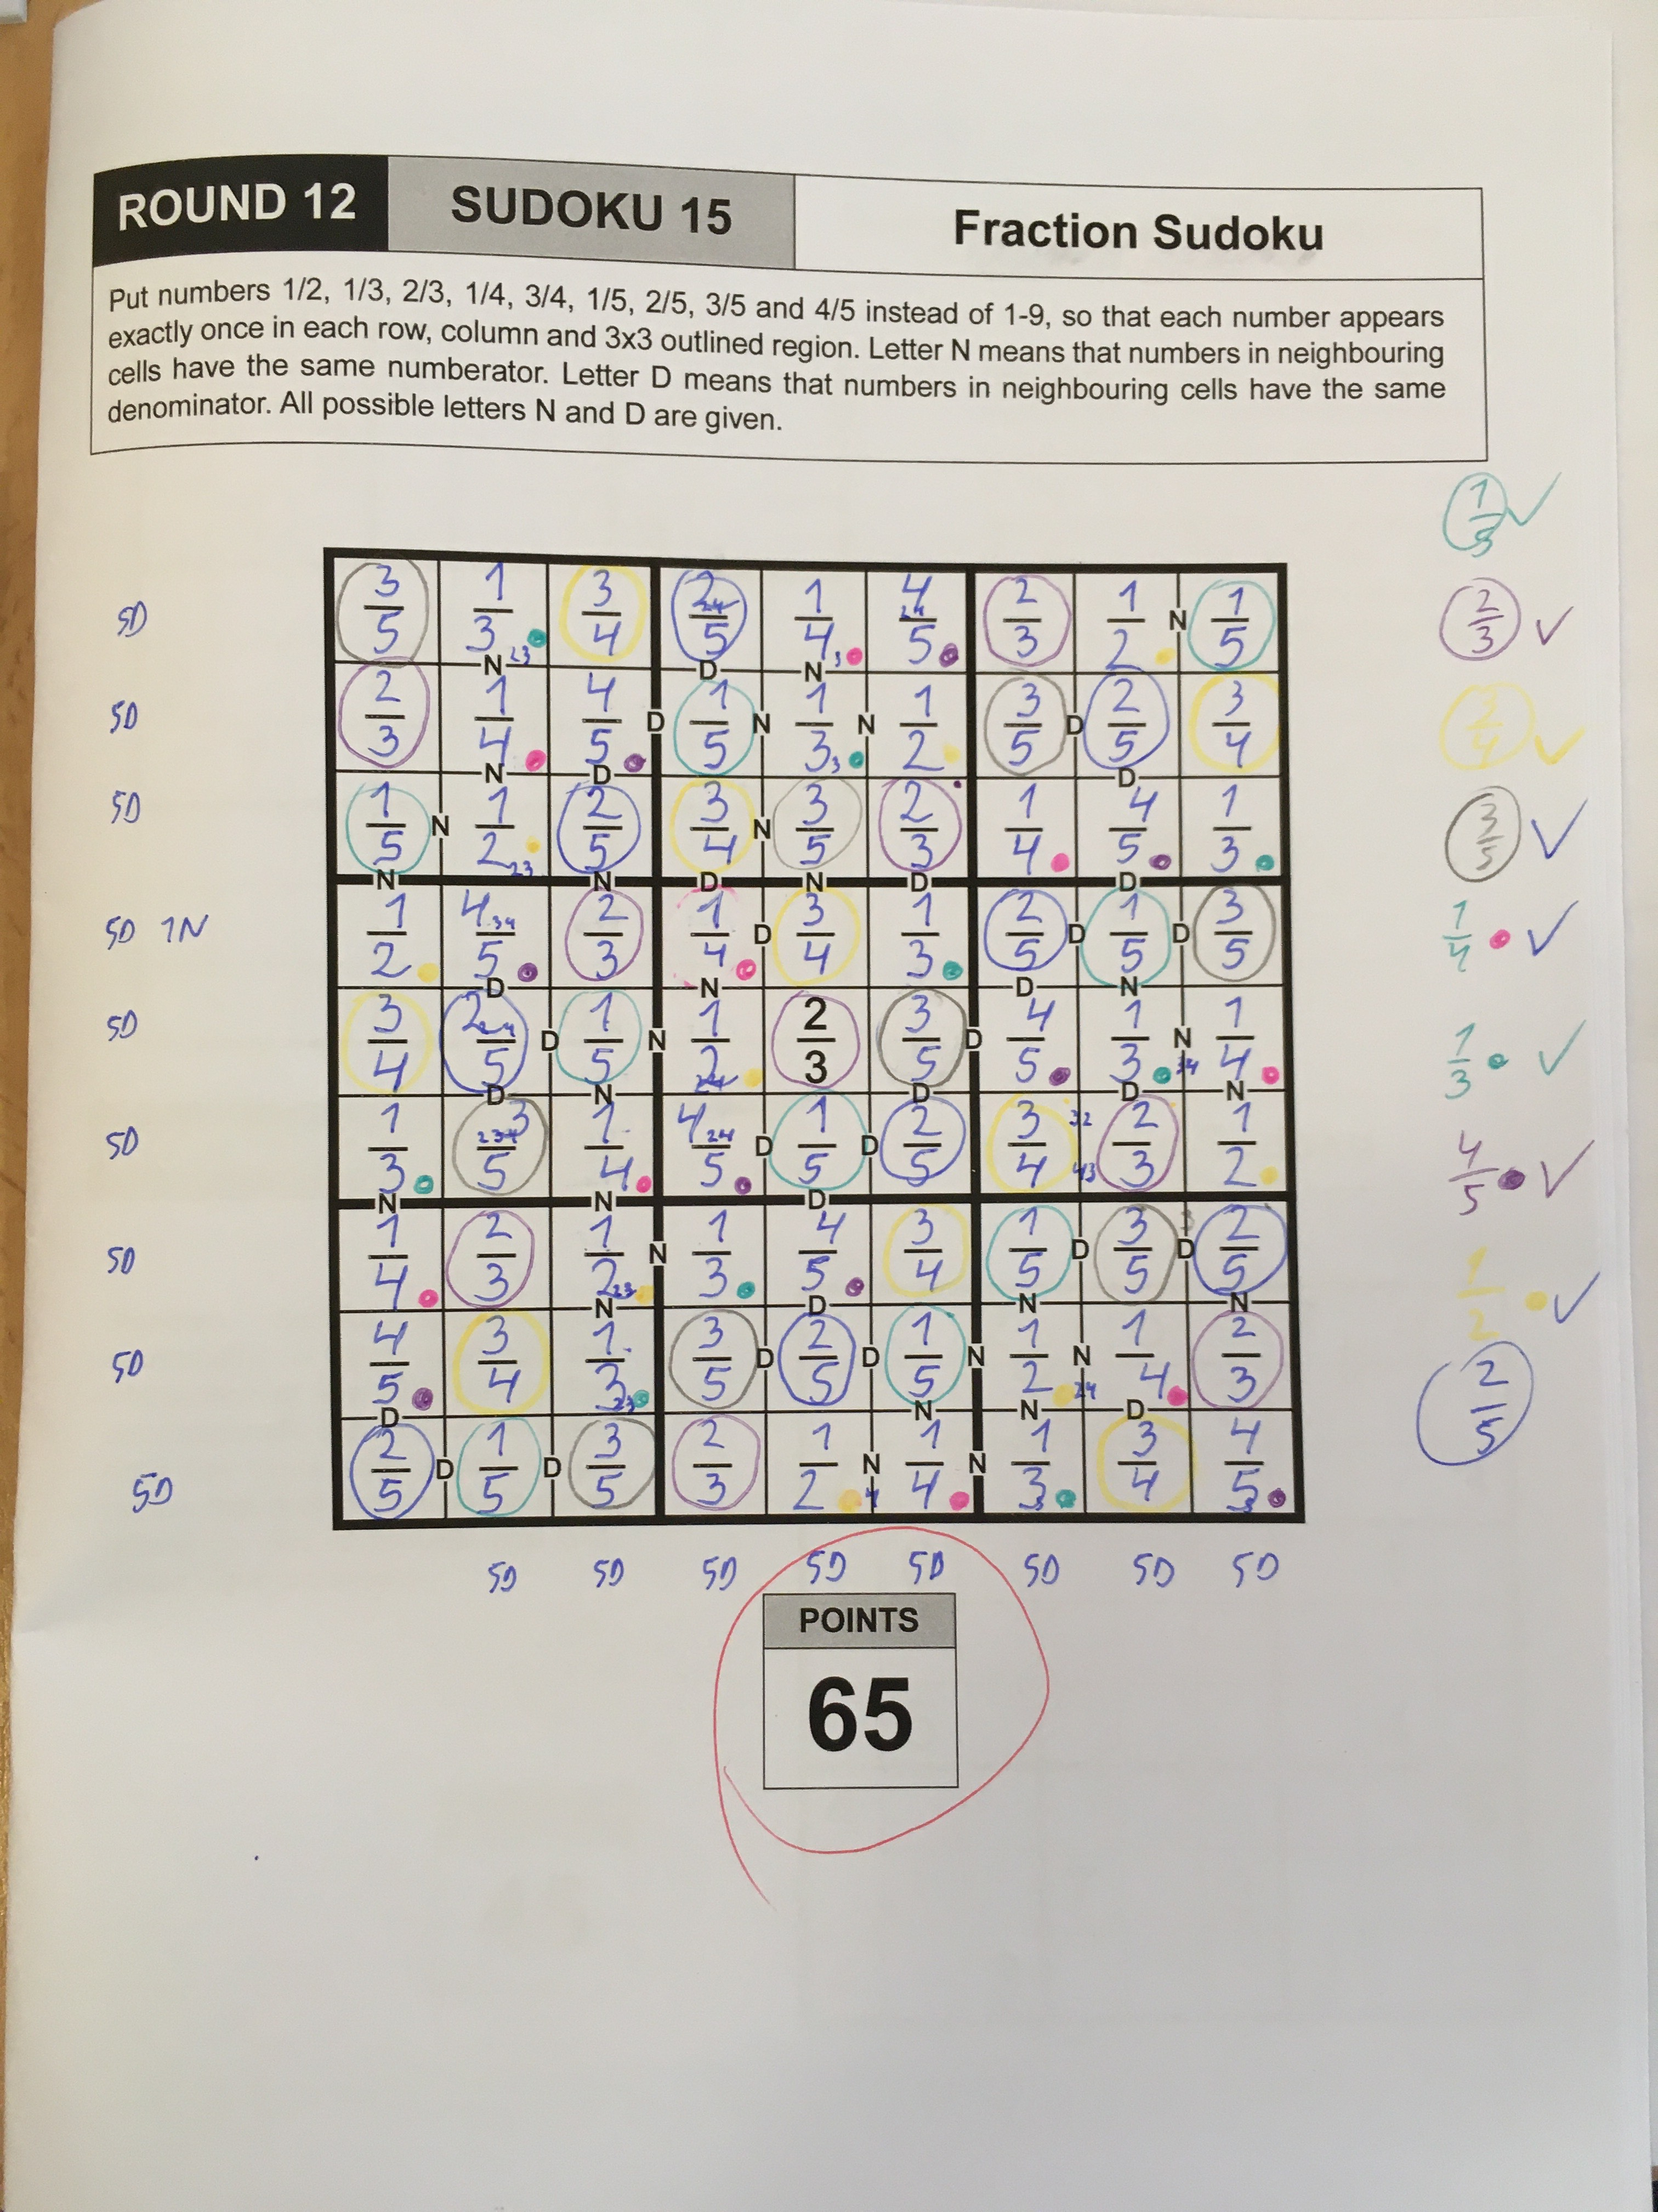

Slide 32
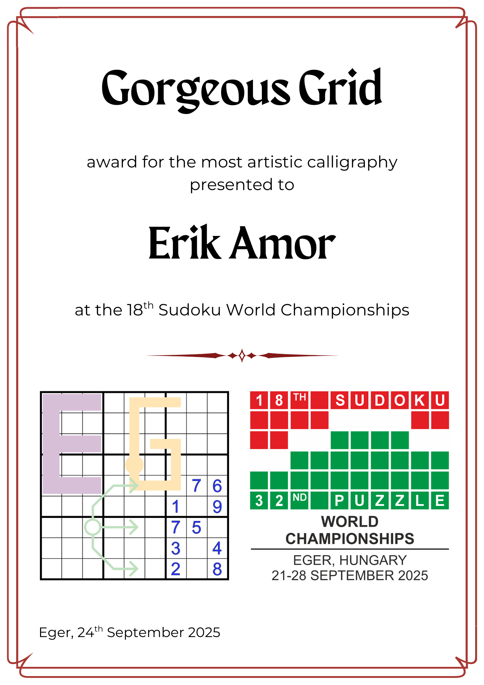

Slide 33
PRACTICE MAKES PERFECT

Slide 34
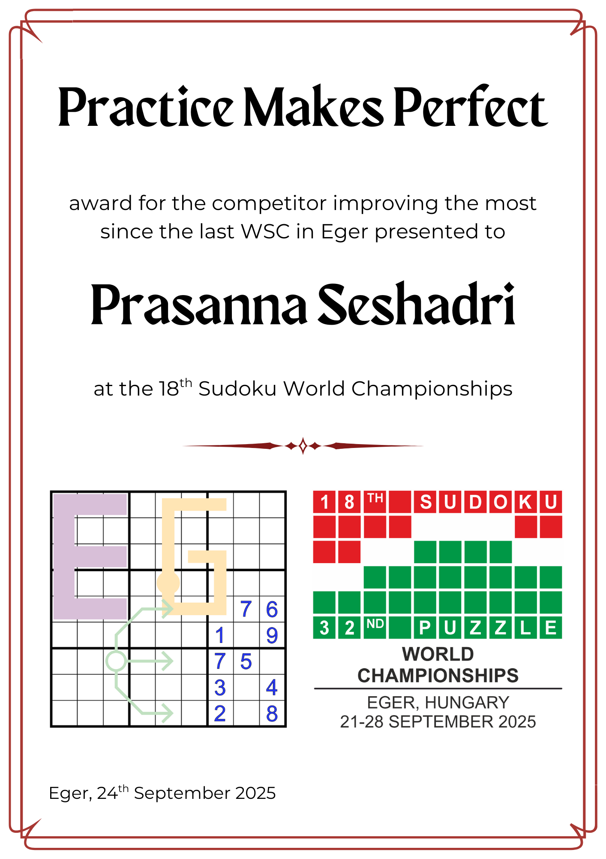

Slide 35
HOME SWEET HOME

Slide 36
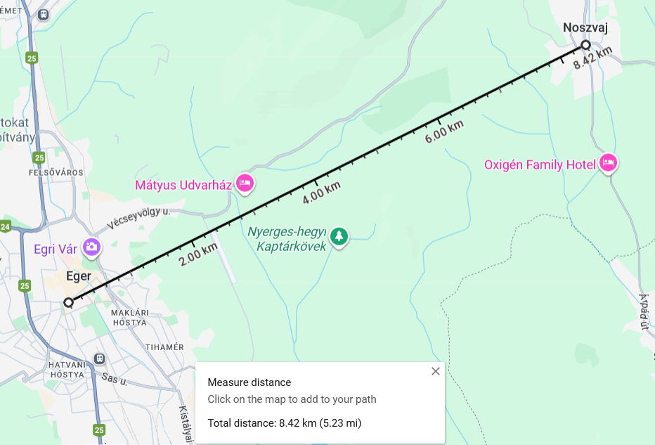

Slide 37
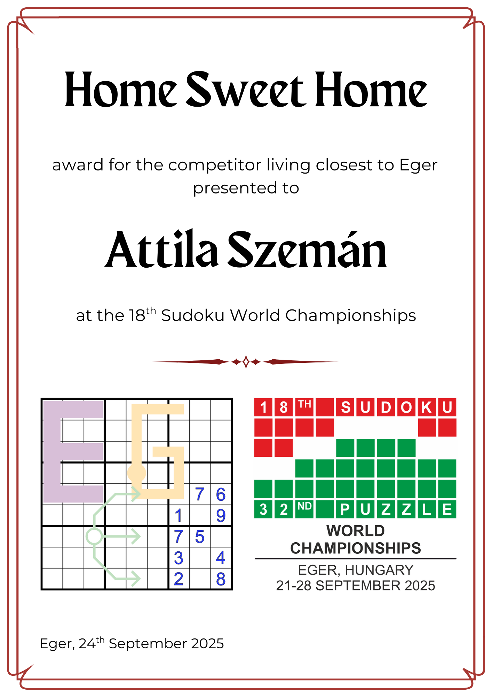

Slide 38
MILES & MORE

Slide 39
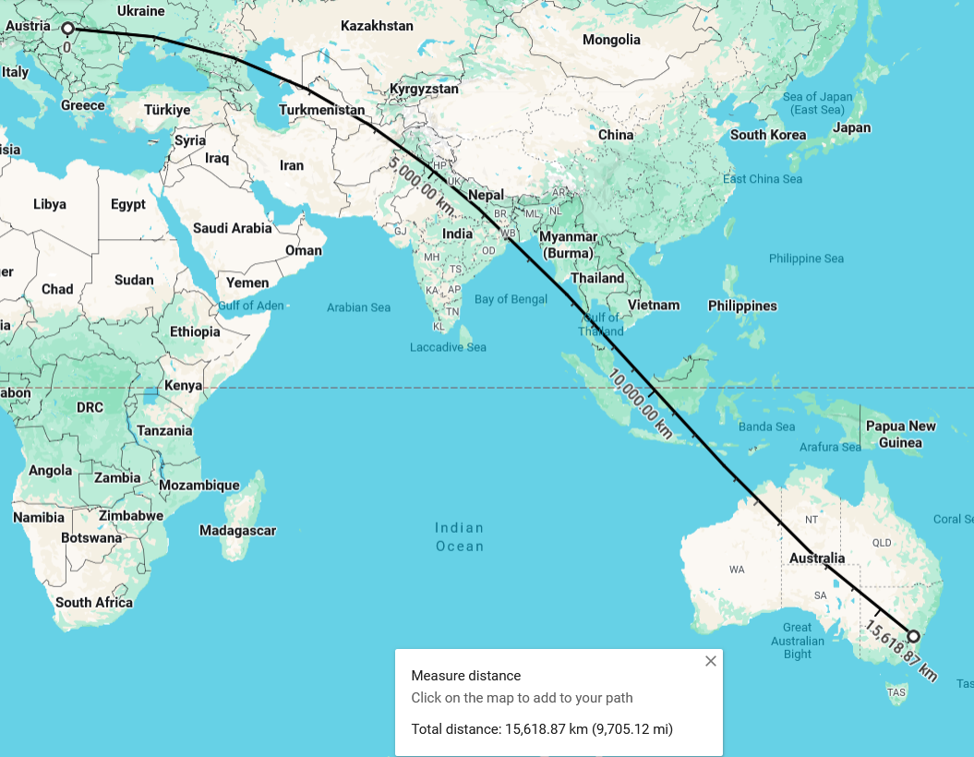

Slide 40
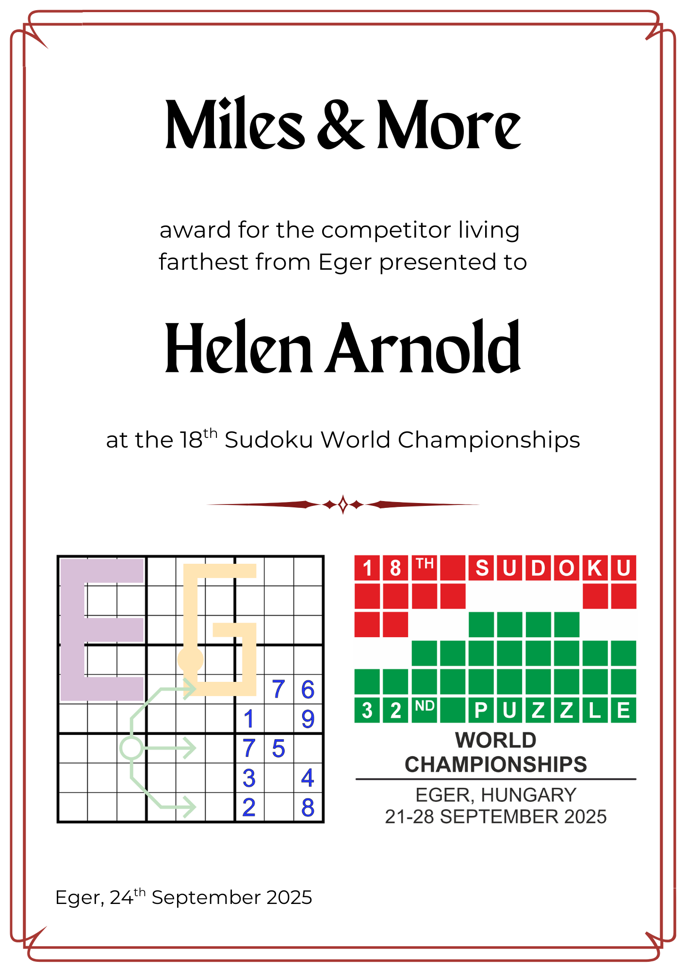

Slide 41
DUEL CHAMPION

Slide 42
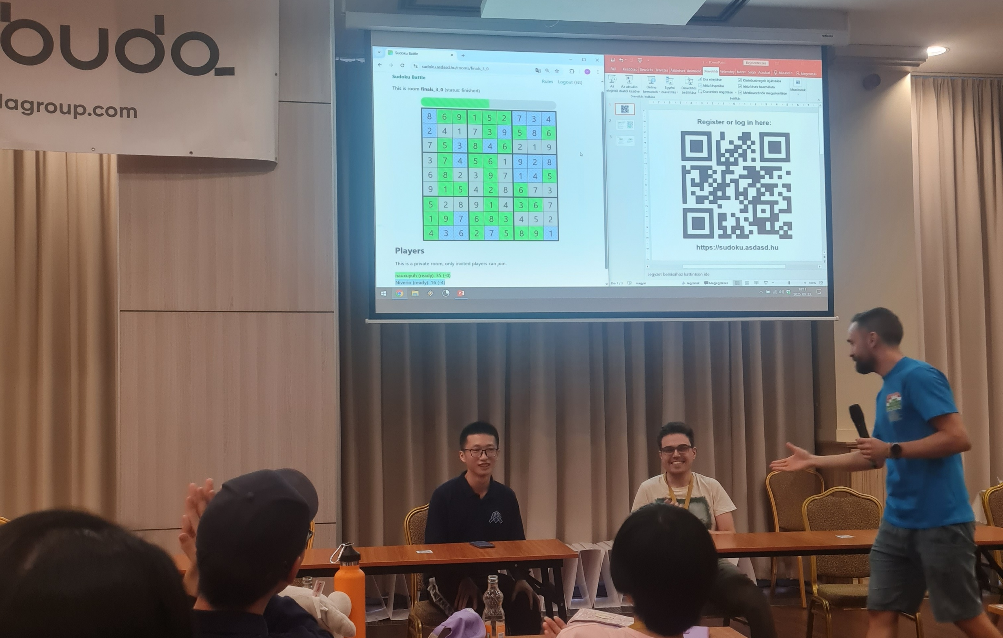

Slide 43
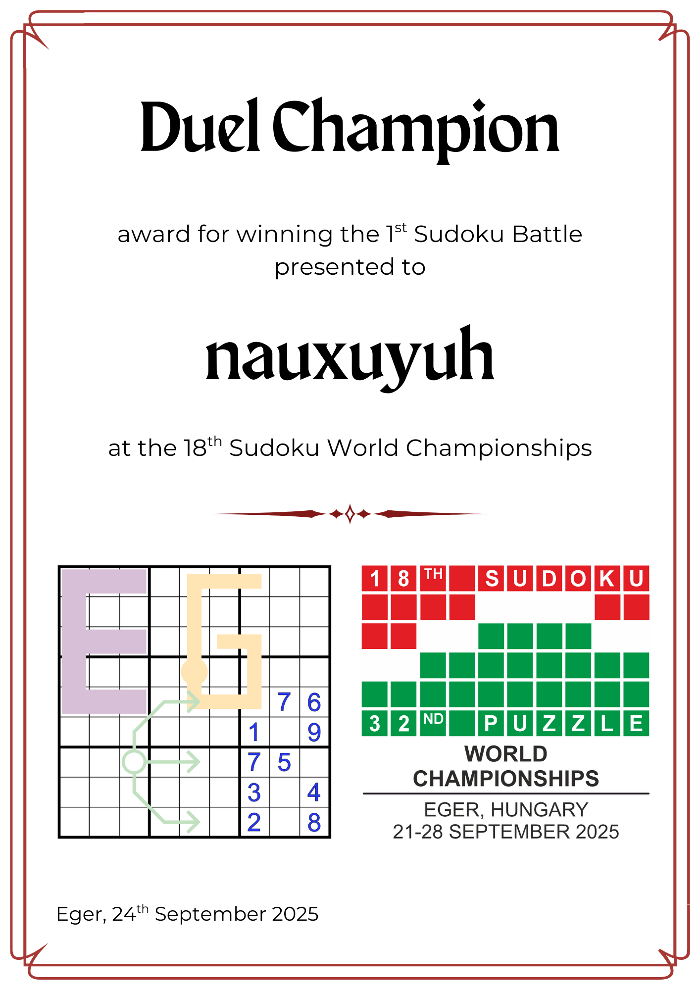

Slide 44
LOST IN TRANSLATION

Slide 45

IND-A

Slide 46
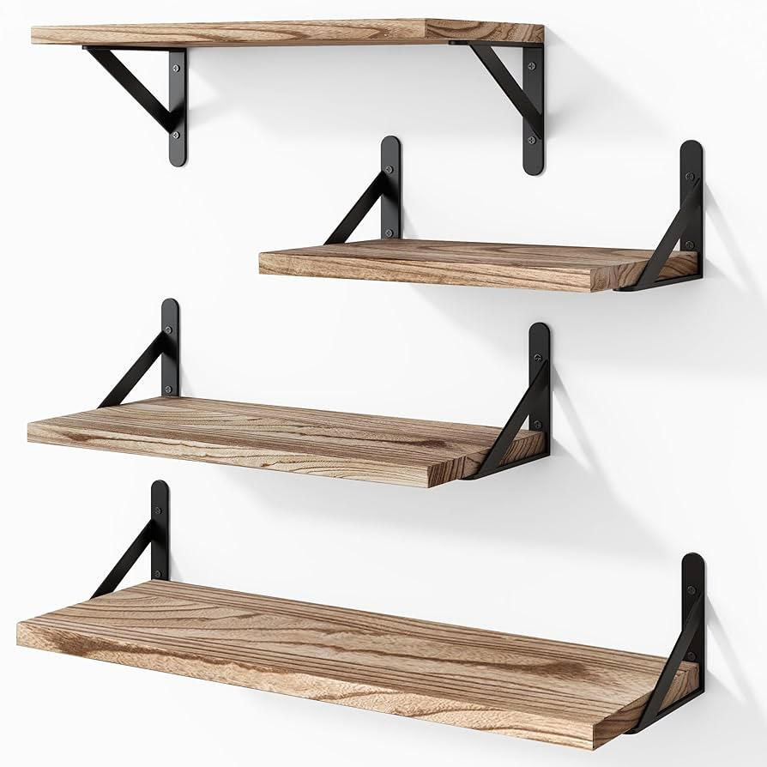
POL-C

Slide 47

BUL-A

Slide 48
subliminal message

Slide 49
Zoltán Horváth
Zoltán Németh
Zoltán Gyimesi
Zoltán Csorba
Zoltán Feleki
Zoltán Héder
Zoltán Tőri
2025 Organizer Team contains several Zoltán.
The general nickname of Zoltán is ZOLI in Hungarian

Slide 50
